Slide 1

EARTHY 4.0 Group 6
Anurag Sonar 5201756
Diederik Jilderda 4096449
Karin Backer 4552962
Pragya Chauhan 5319110
Notes:
Who we are
Health care in Zaatari

Slide 2
Content
Introduction
Design Problem
Vision and Project
Process Flow Chart
Analysis
Site
Compounded query
Final location
Configuration
Function Program
Space Syntax / REL Chart / Bubble Diagram
Grid / Size and Shape / Wall Module
Space Planning
Function Modules
Density Factor
Space Layout Configurations
Shaping
Roof typology analysis
Circulation
Isometric modules
Construction

Slide 3

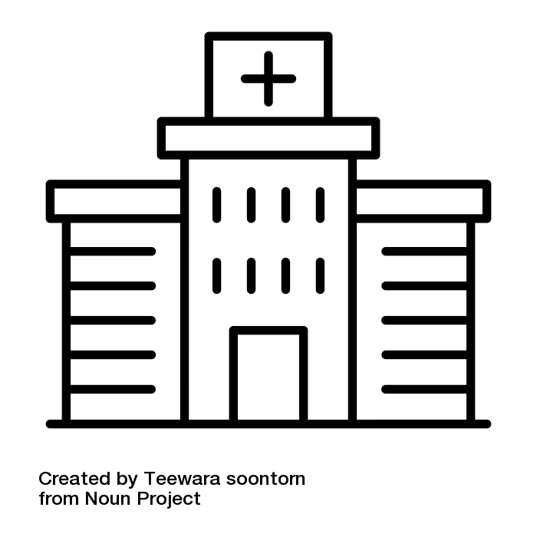

1.1 | Introduction | Design Problem
Disproportionate distribution of medical facilities in sectors as per density.
High pressure on major healthcare facilities as they as less in number.
The walking distance to health care facilities is high in certain sectors, sometimes greater than 800m.

Slide 4
1.2 | Introduction | Vision & Project
Making basic and supplementary healthcare more accessible to the people of Zaatari.
Our aim is to create a flexible tool to design hospitals based on specific local and urban needs.

Slide 5
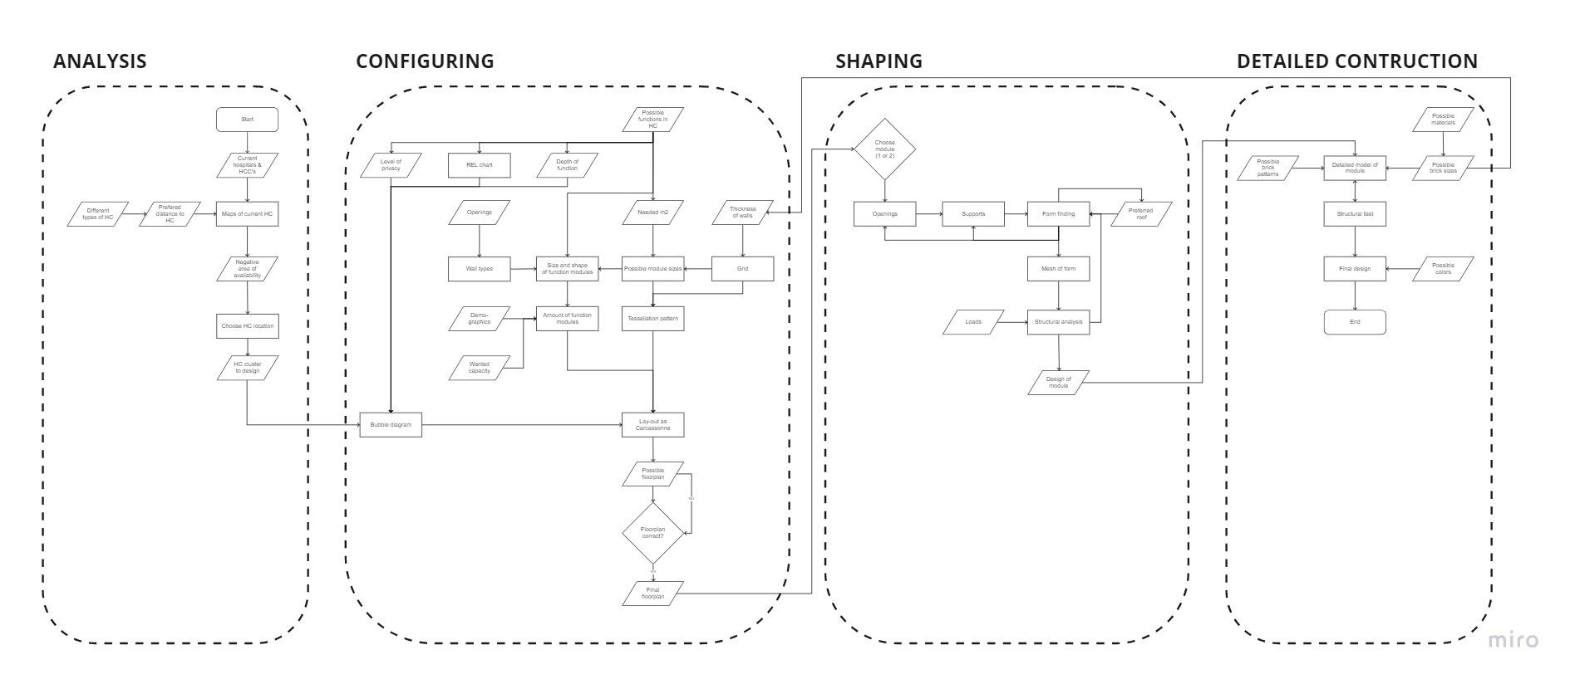
1.3 | Introduction | Process Flowchart

Slide 6
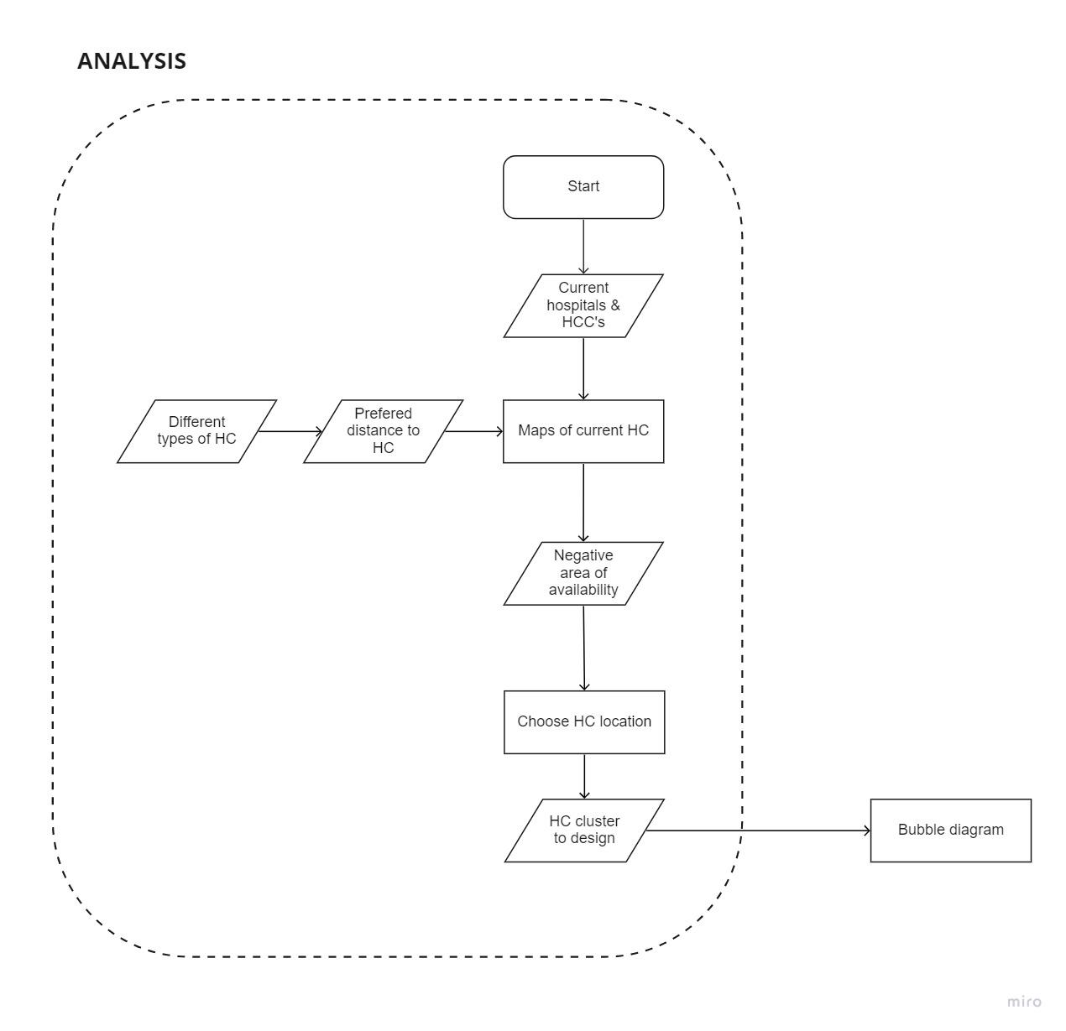
2.0 | Analysis

Slide 7
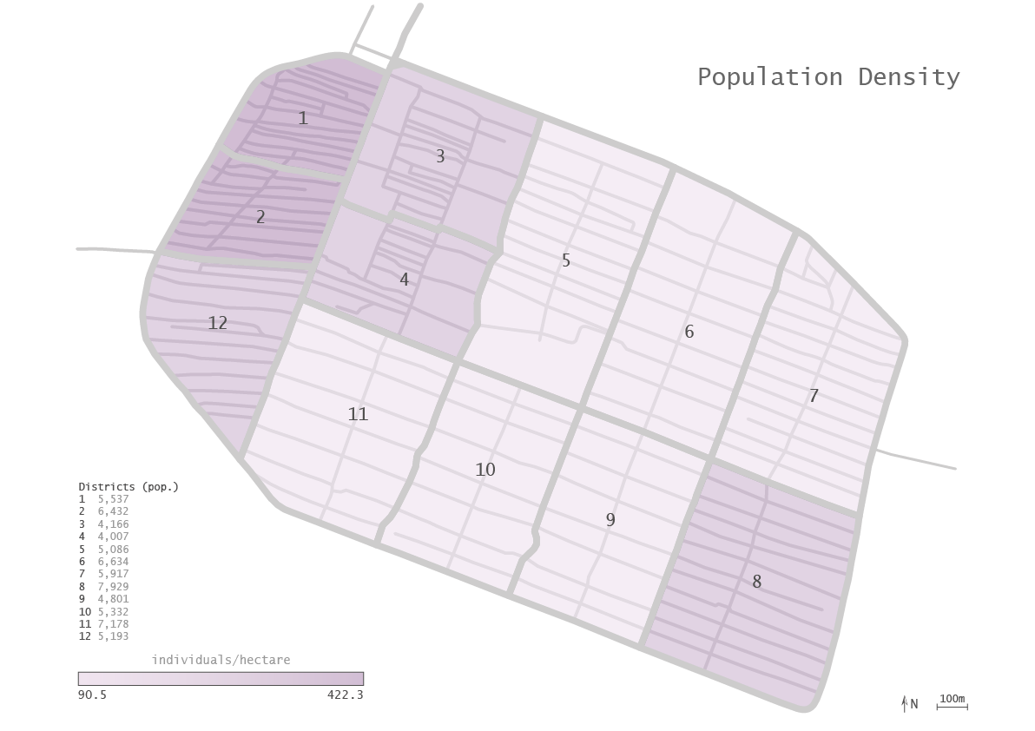
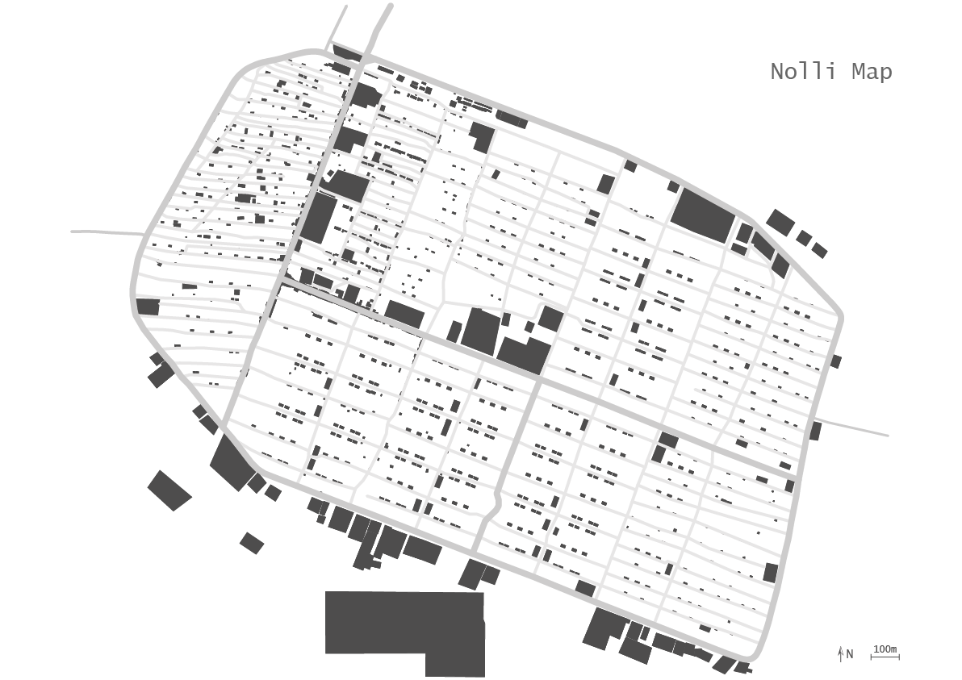
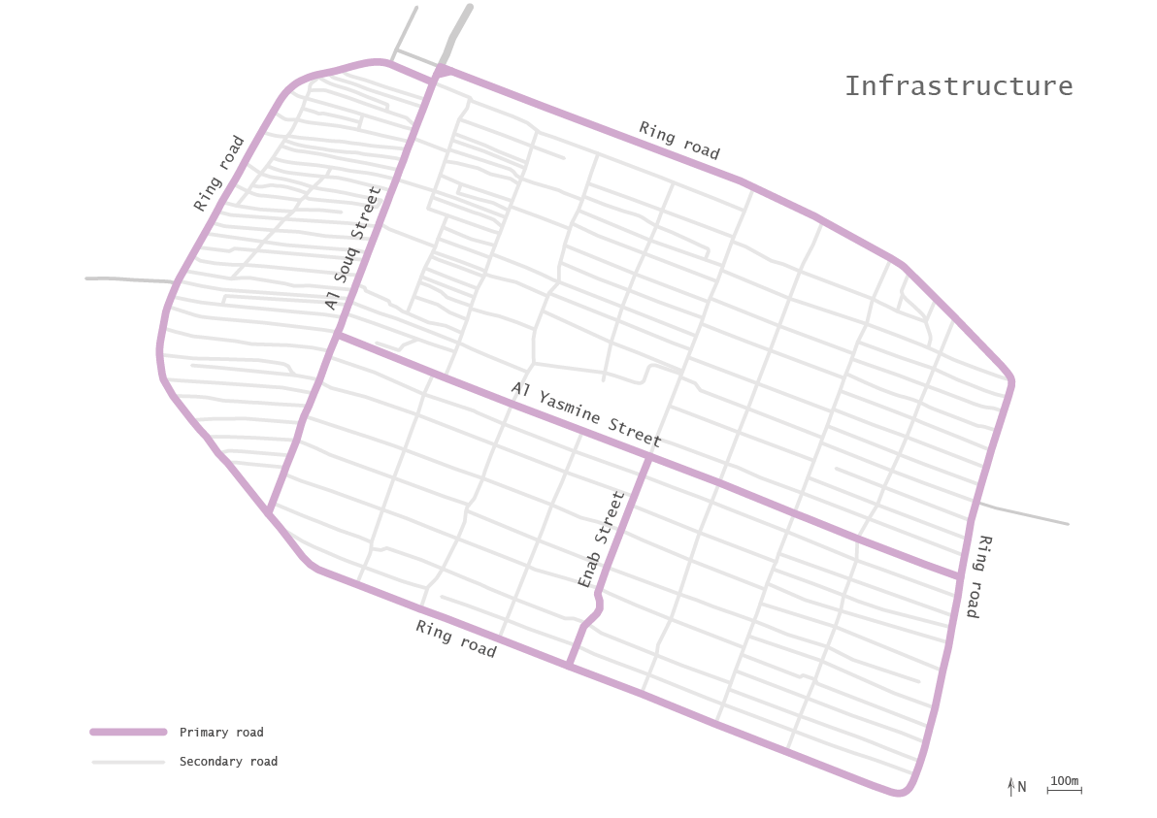
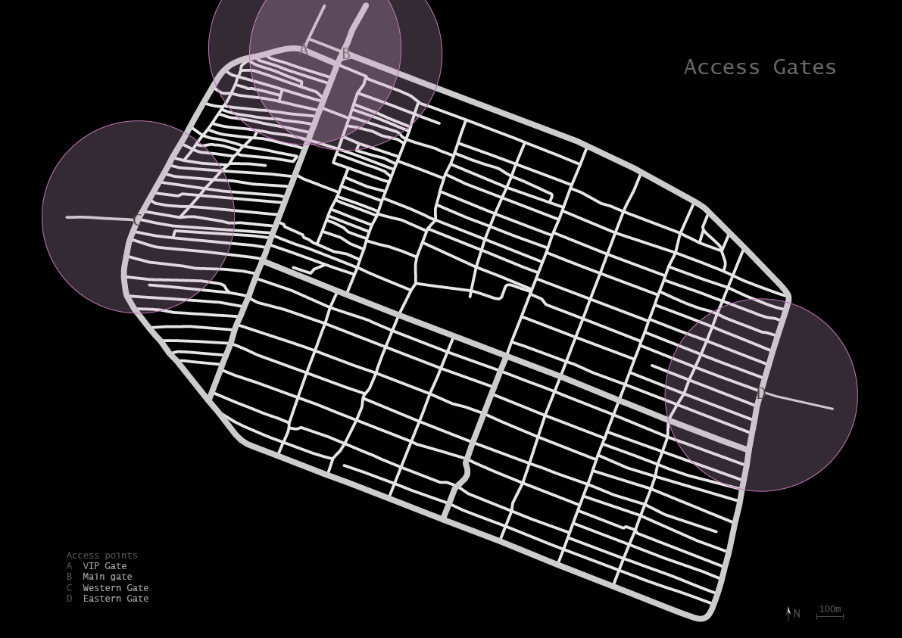
2.1 | Analysis | Site

Slide 8
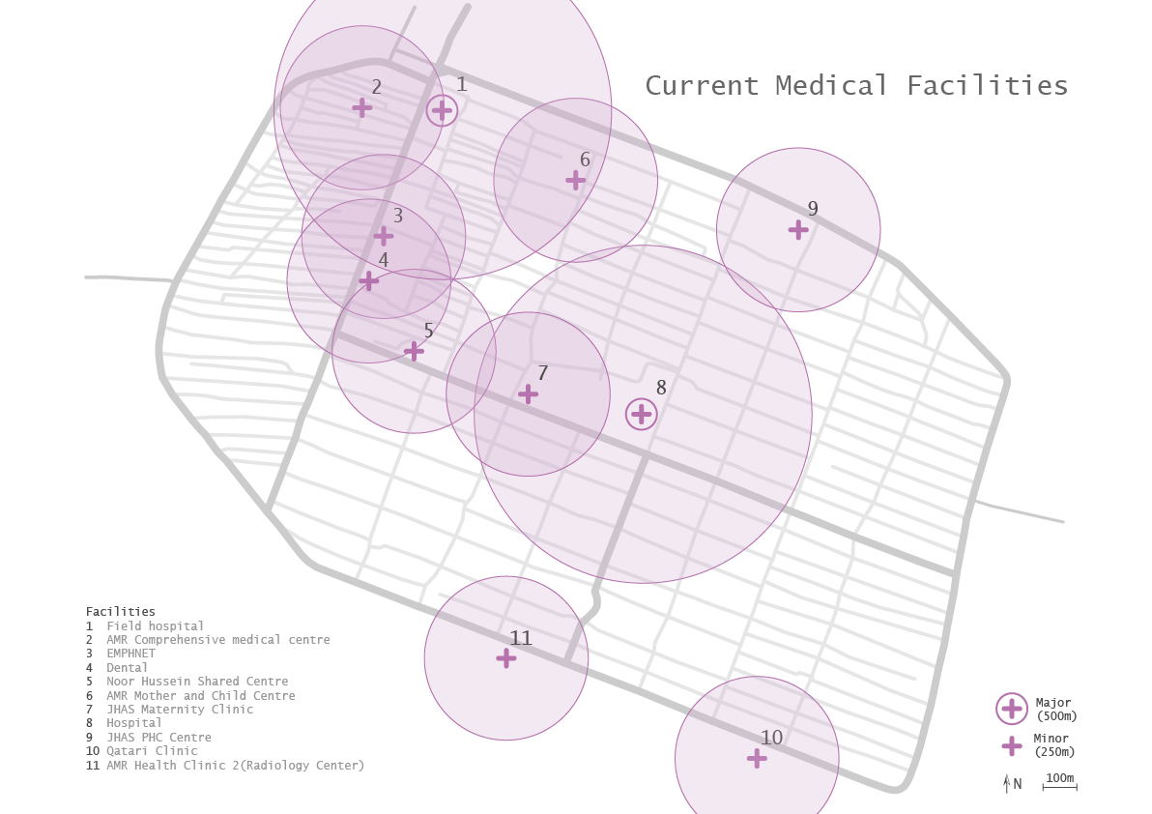
2.1 | Analysis | Site
Organisation
Facilities are sorted by scale:
Small local clinics and large regional hospitals.
Decentralized local clinics improve accessibility for day-to-day care;
Centralized regional hospitals improve efficiency at providing specialized care.

Slide 9
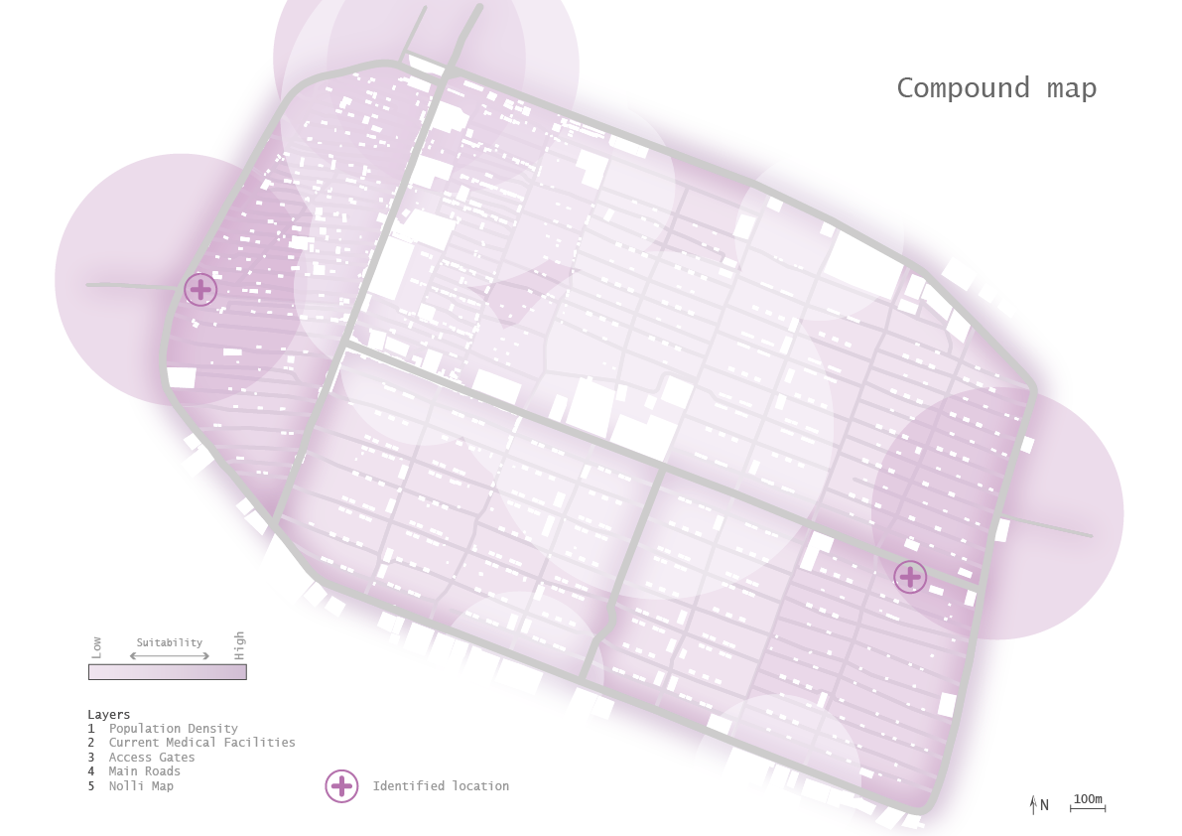
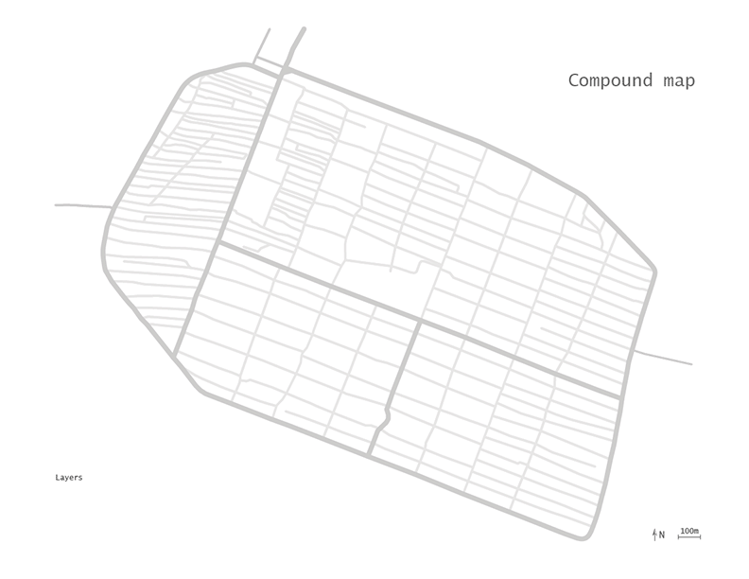
2.1 | Analysis | Compounded query

Slide 10
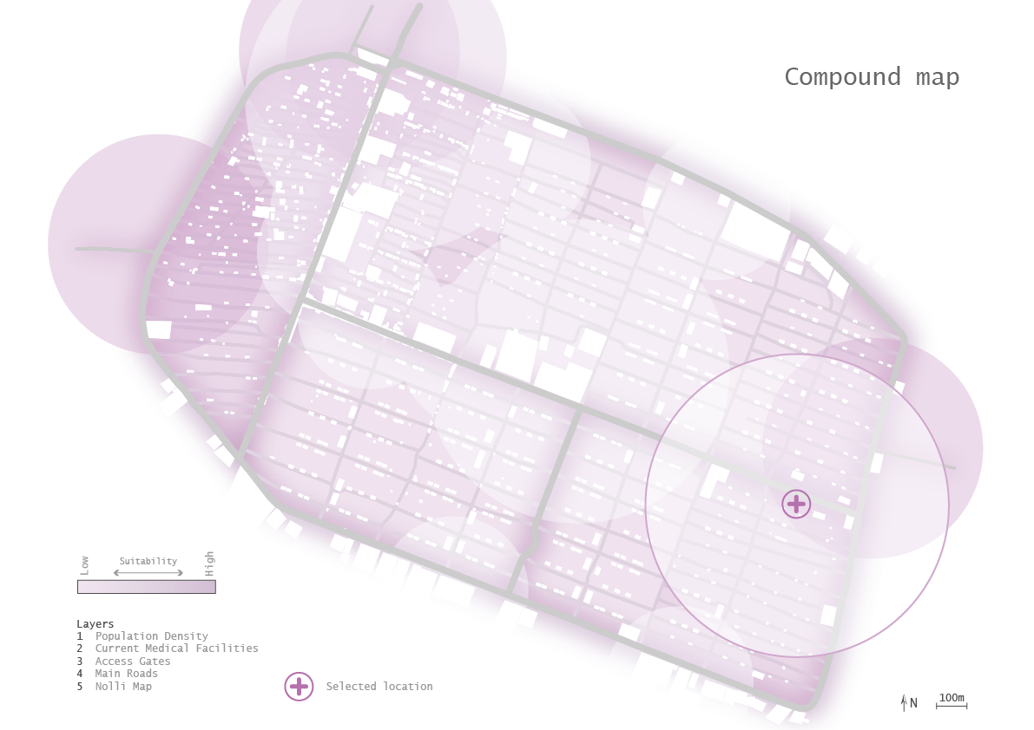
2.1 | Analysis | Location selection
Notes:
Diederik
(mention the locations spotting gh)

Slide 11
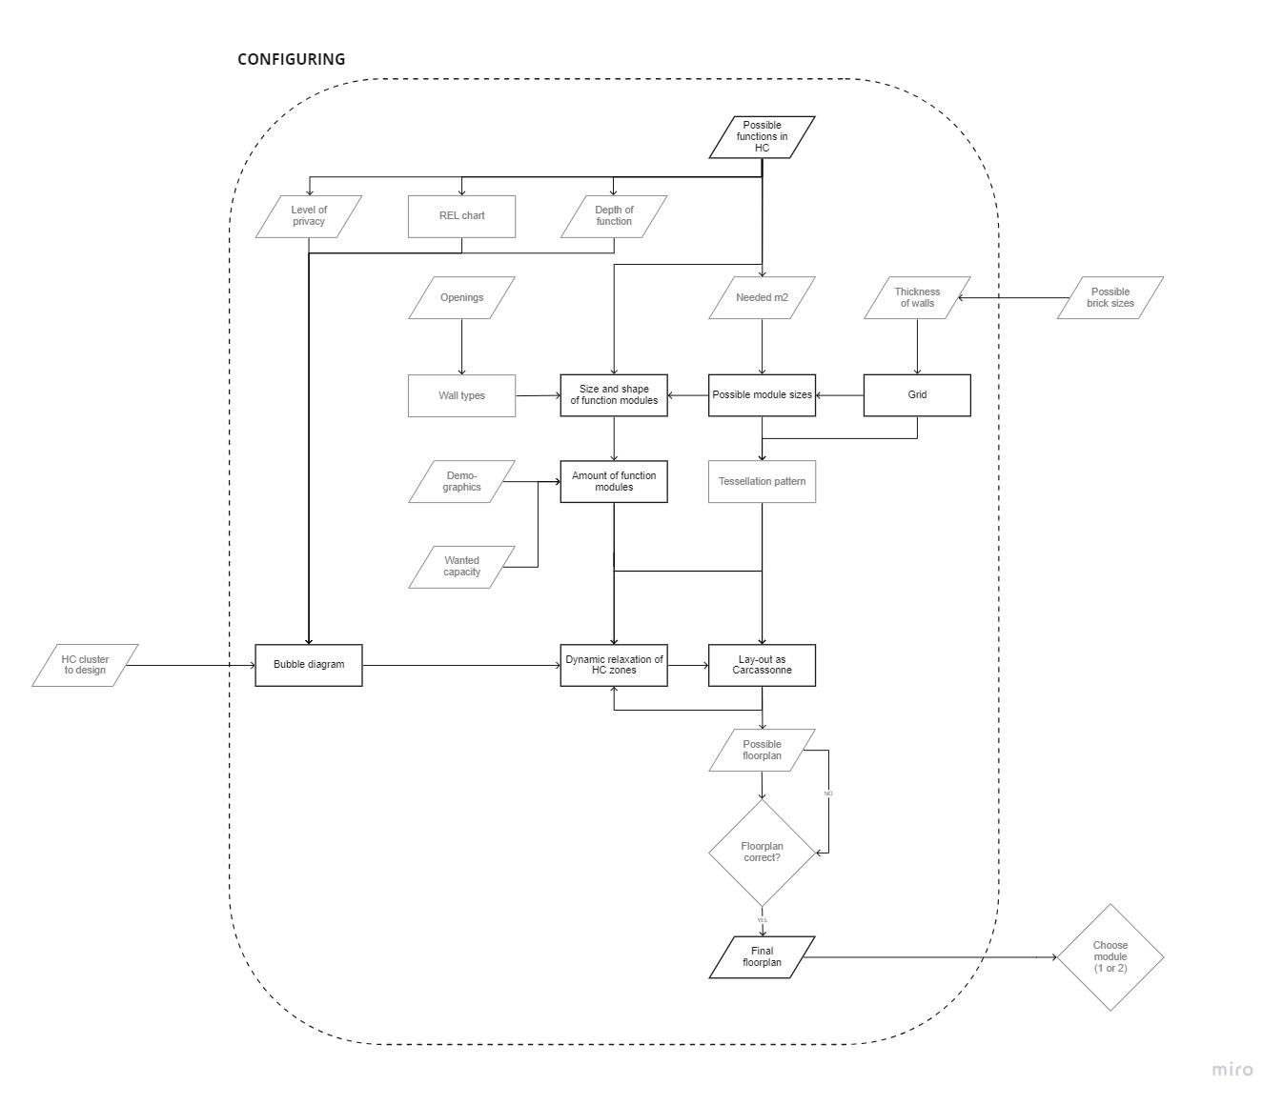
3.0 | Configuring

Slide 12
3.1 | Configuring | Function Program
 | Function name | Space accessibility | Area* | Capacity**
Connection Functions | Circulation Green Spaces / Courtyard | Public Public | 33% of total 40% of total
Basic Functions | Fore-court / Waiting Area Reception General Toilets Primary Healthcare Unit - PHU Emergency Care | Public Public Public Semi-private Semi-private | 3x sqm 2x sqm x sqm 3x sqm 3x sqm | 50 50 20 20 10
Additional Functions | Pharmacy Hall for counselling/awareness/immunization drives Cafeteria + kitchen Oral Health Unit Womens and Childcare Unit Rehabilitation Unit Ward Showers Lab Records Room Staff Room | Public Public Public Semi-private Semi-private Semi-private Semi-private Private Private Private Private | 2x sqm 5x sqm 5x sqm 3x sqm 3x sqm 3x sqm 3x sqm x sqm 5x sqm 2x sqm 2x sqm | 20 50 100 20 20 10 5 10 50 50 20
Clinic (small)
Hospital (large)
*Can multiply functions for a bigger hospital. x = 5 sqm is the area for the smallest consultation room as per Neufert Standards.
**Residents per day
Notes:
The area of a particular function is not a number, but denoted as ‘x’. We can provide 2 times or three times the area if required.
Eg - there can be 2 women and child care units in a district which has a larger population of children.

Slide 13
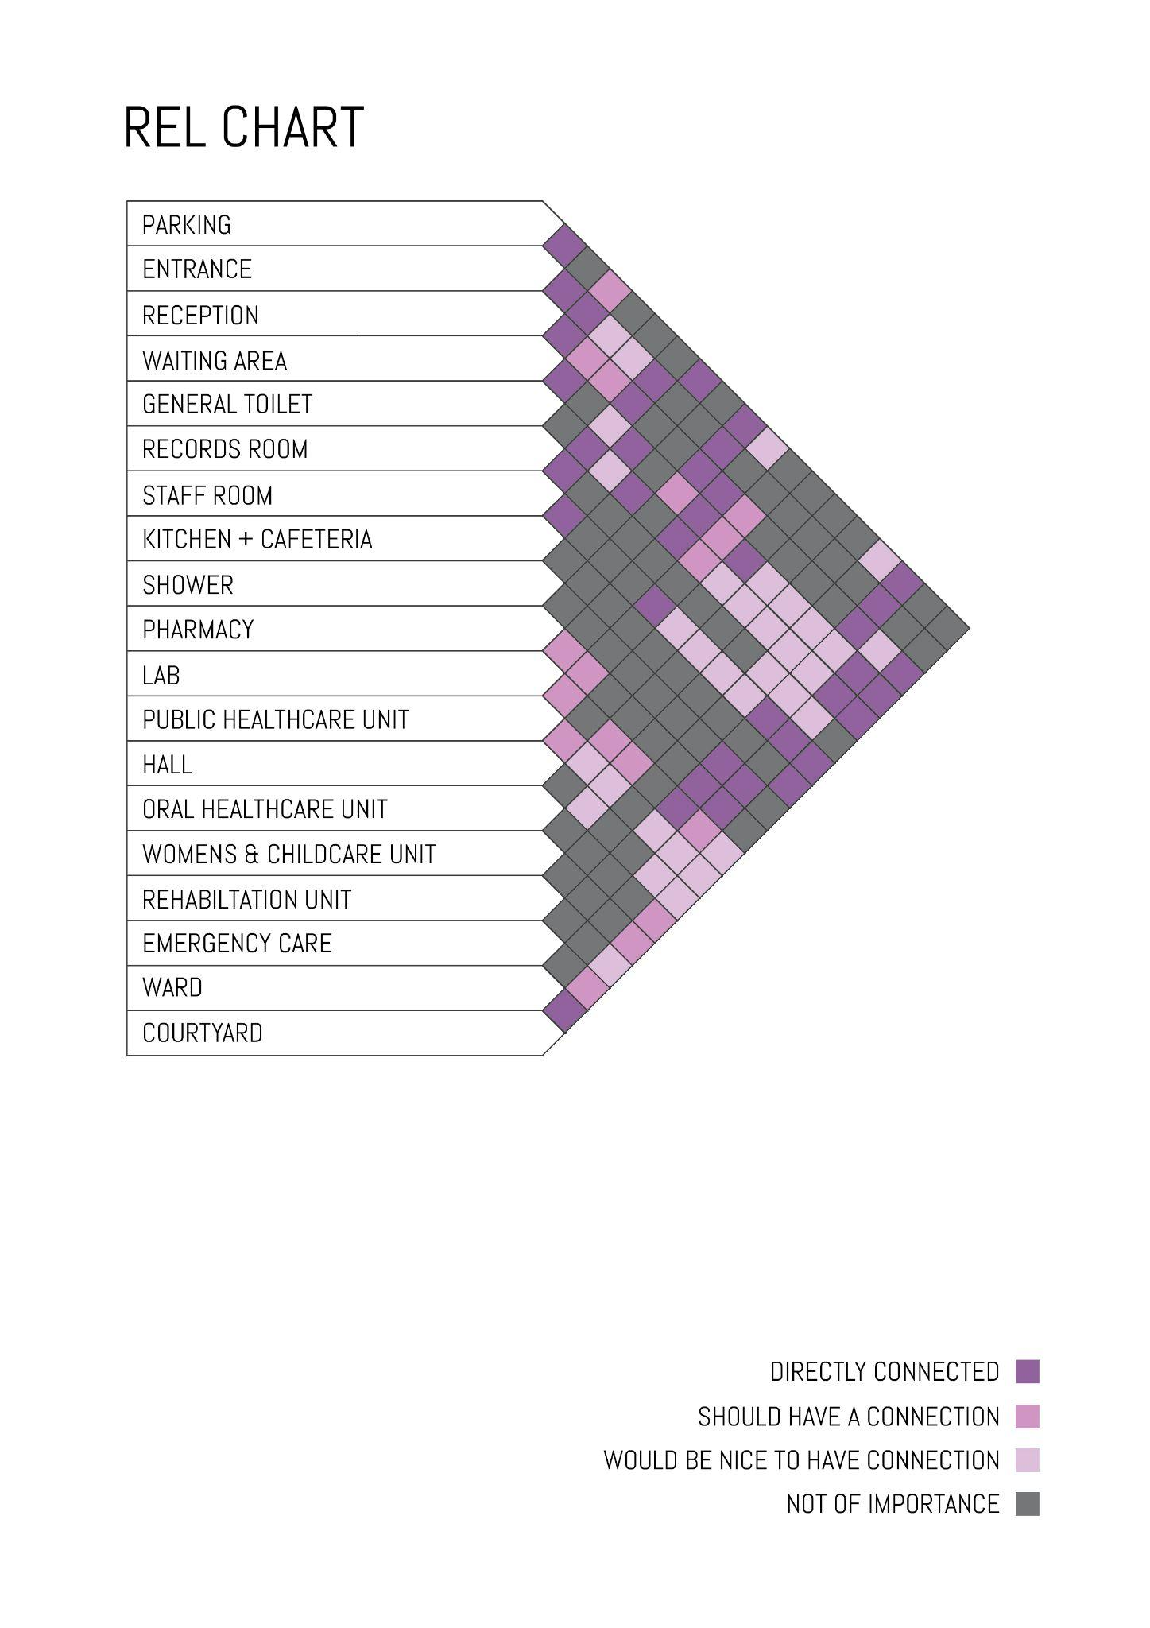
3.2 | Configuring | REL Chart

Slide 14
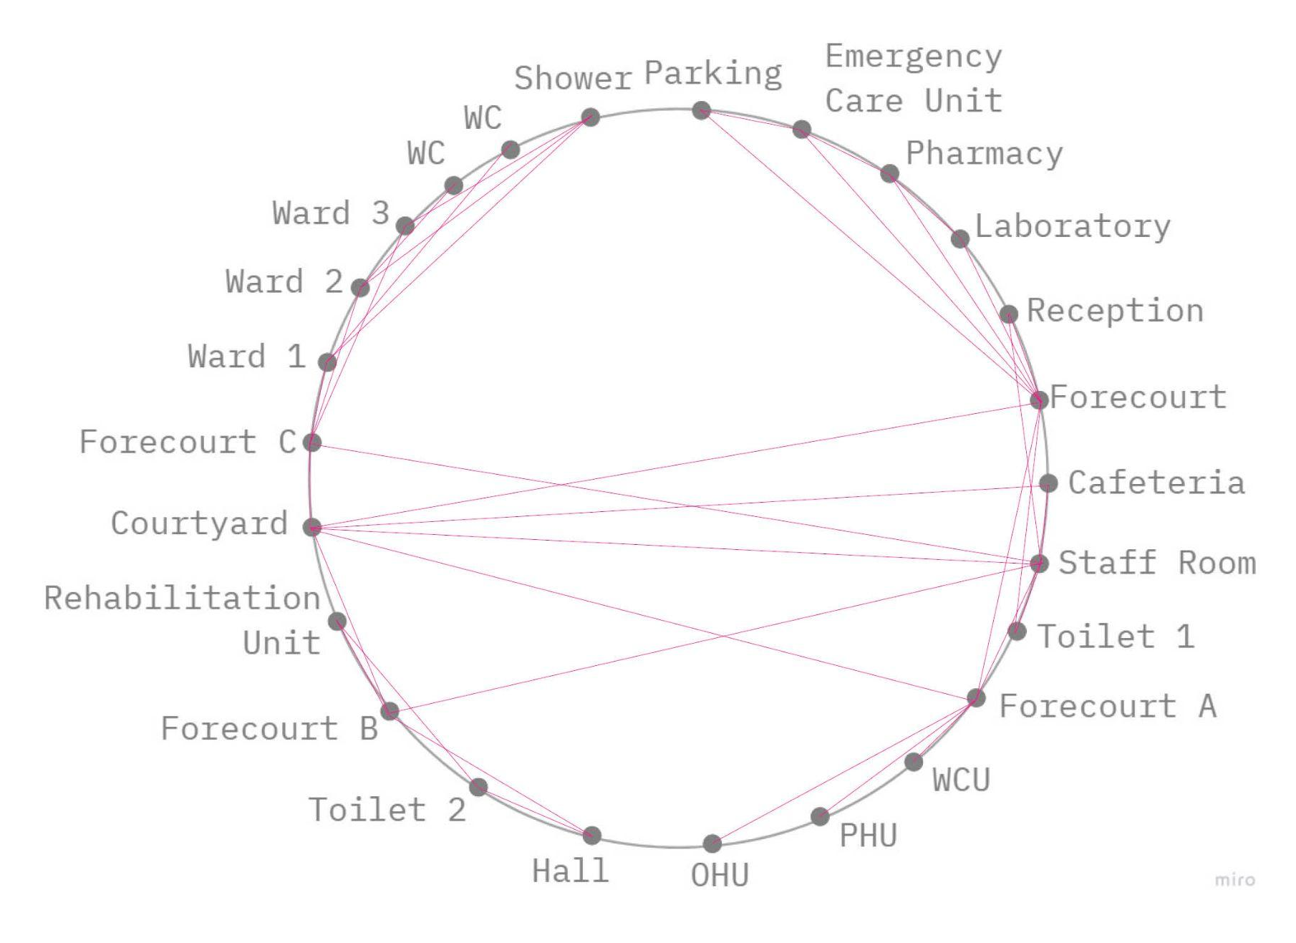
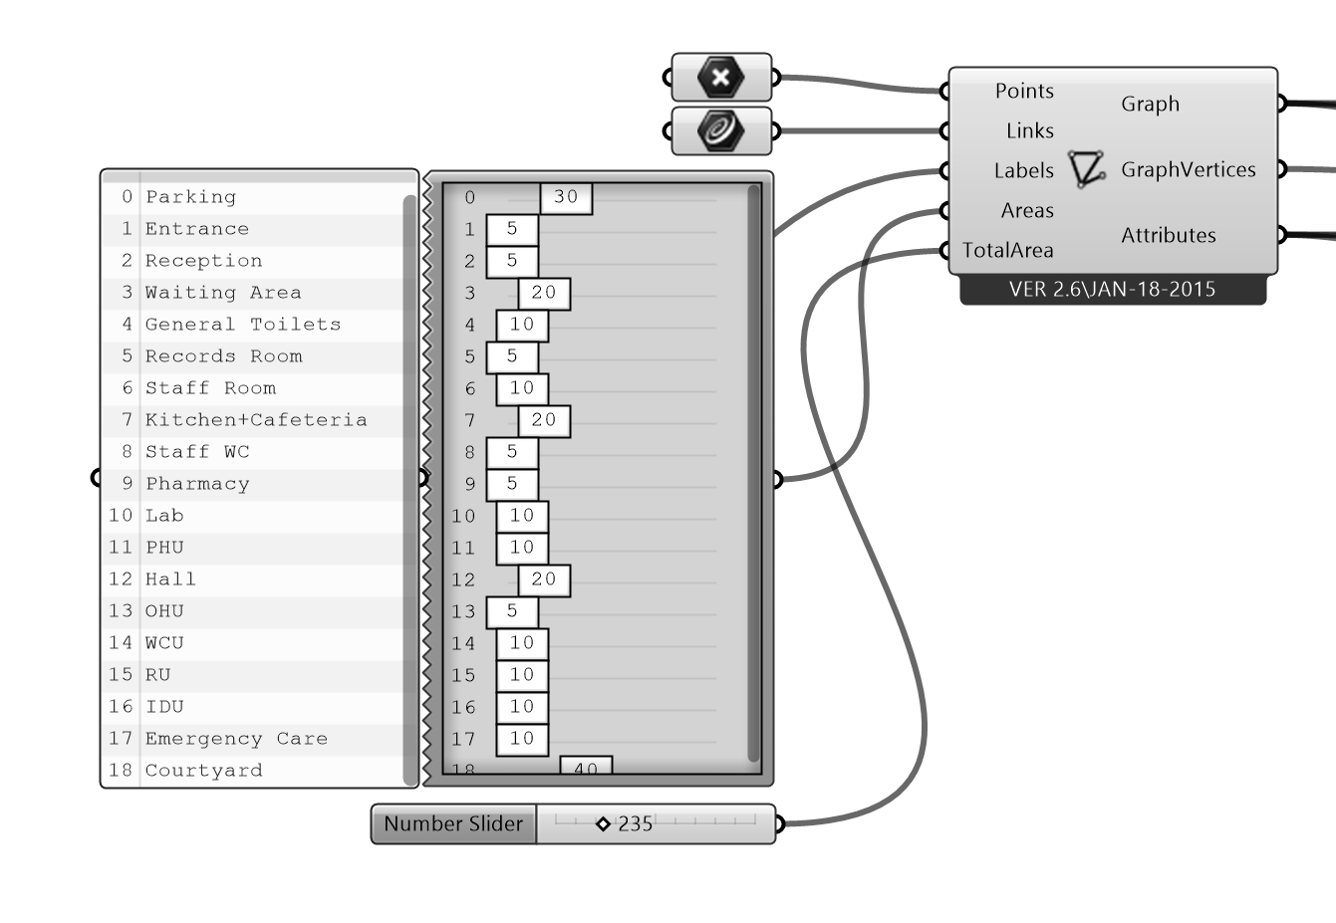
3.2 | Configuring | Function Connectivity Diagram

Slide 15
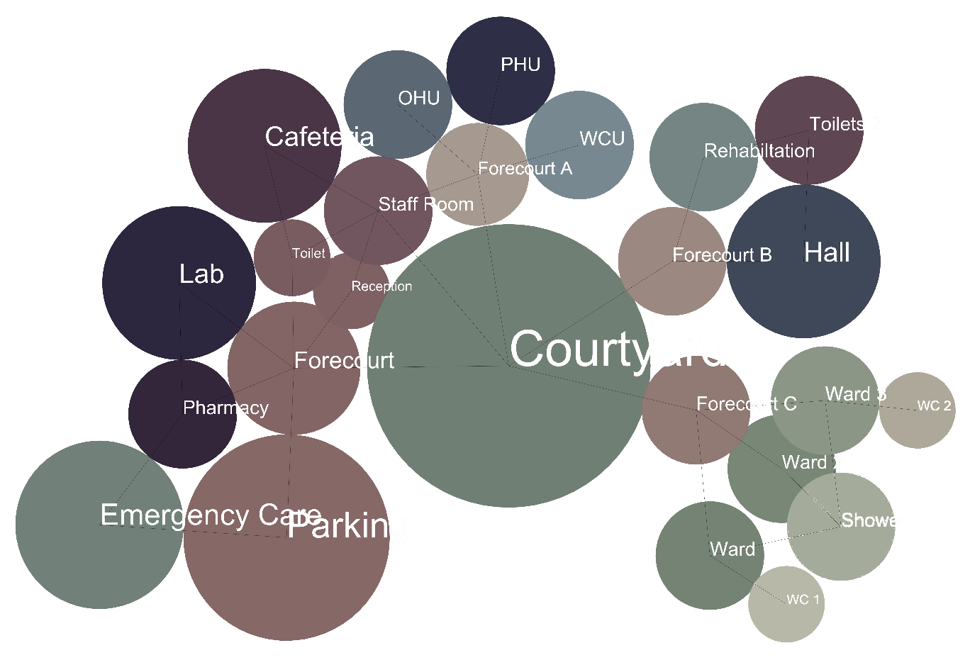
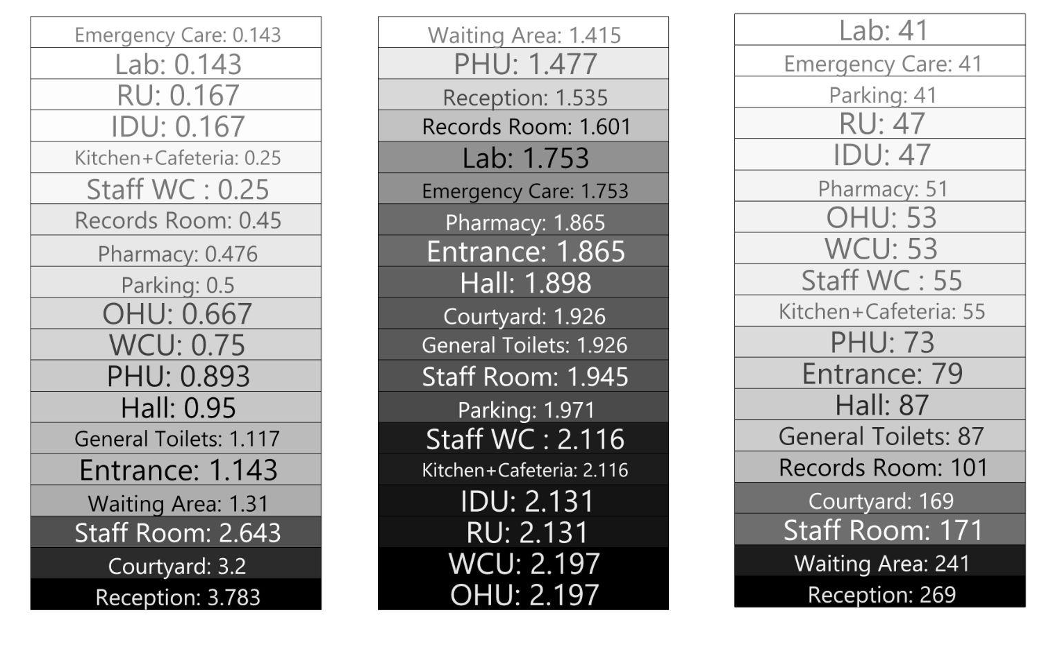
3.2 | Configuring | Bubble Diagram
Outputs
Degree of choice Level of privacy Shortest distance

Slide 16
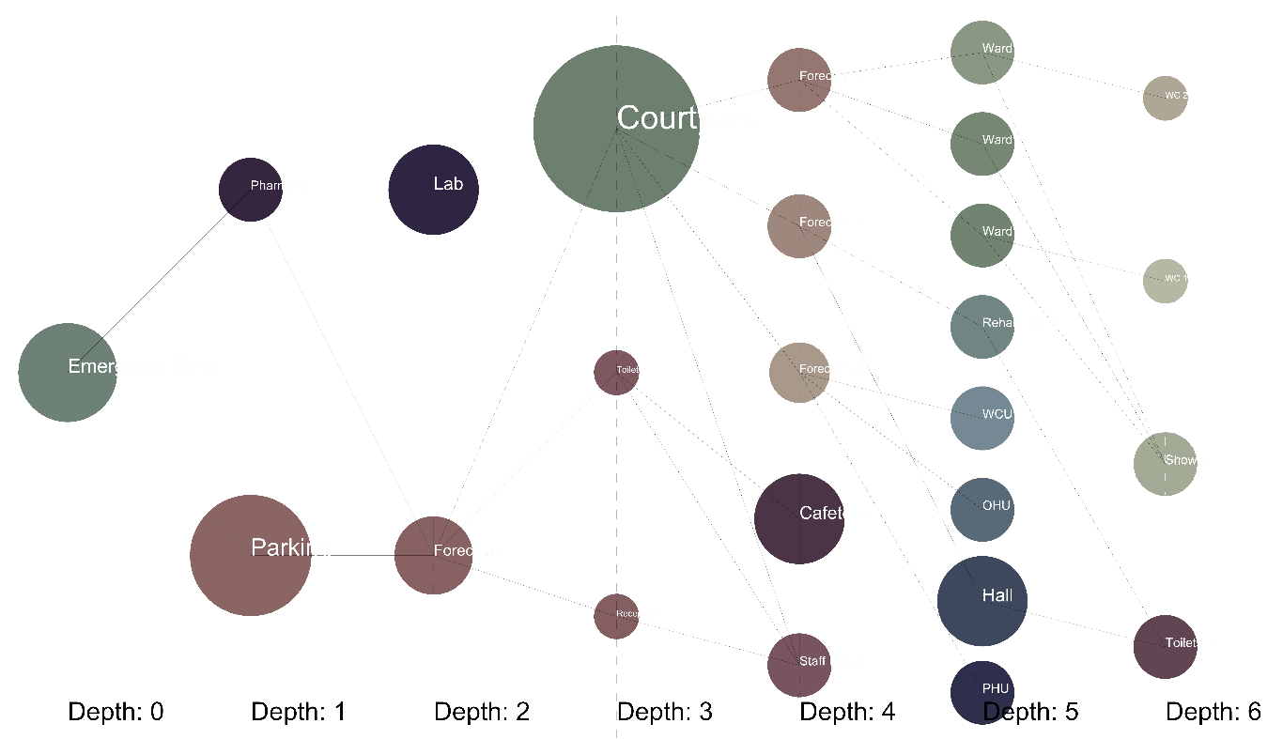
3.2 | Configuring | Justified Graph Drawing

Slide 17
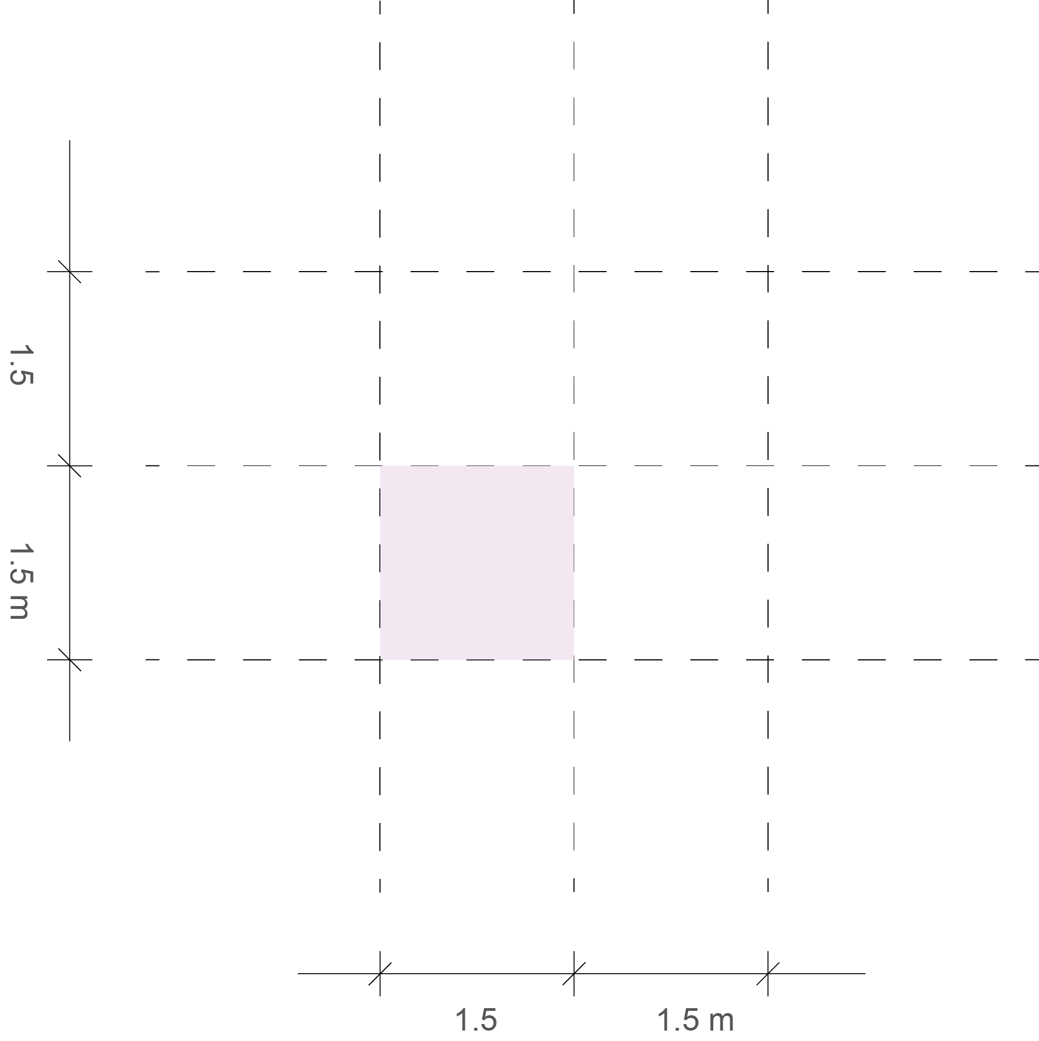
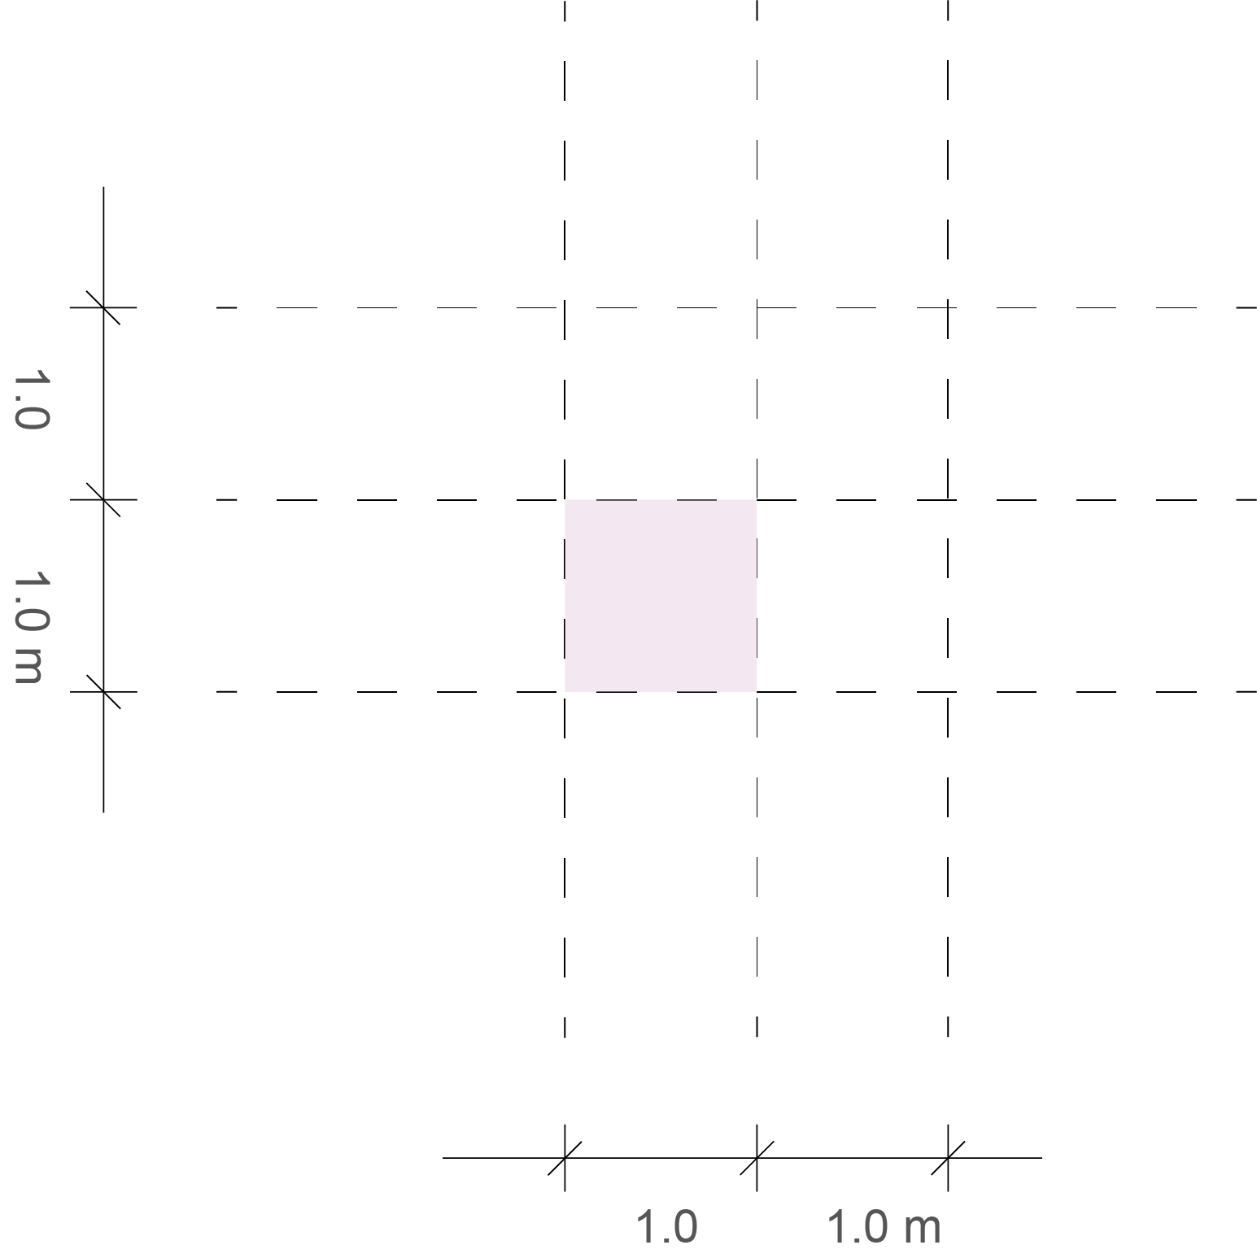

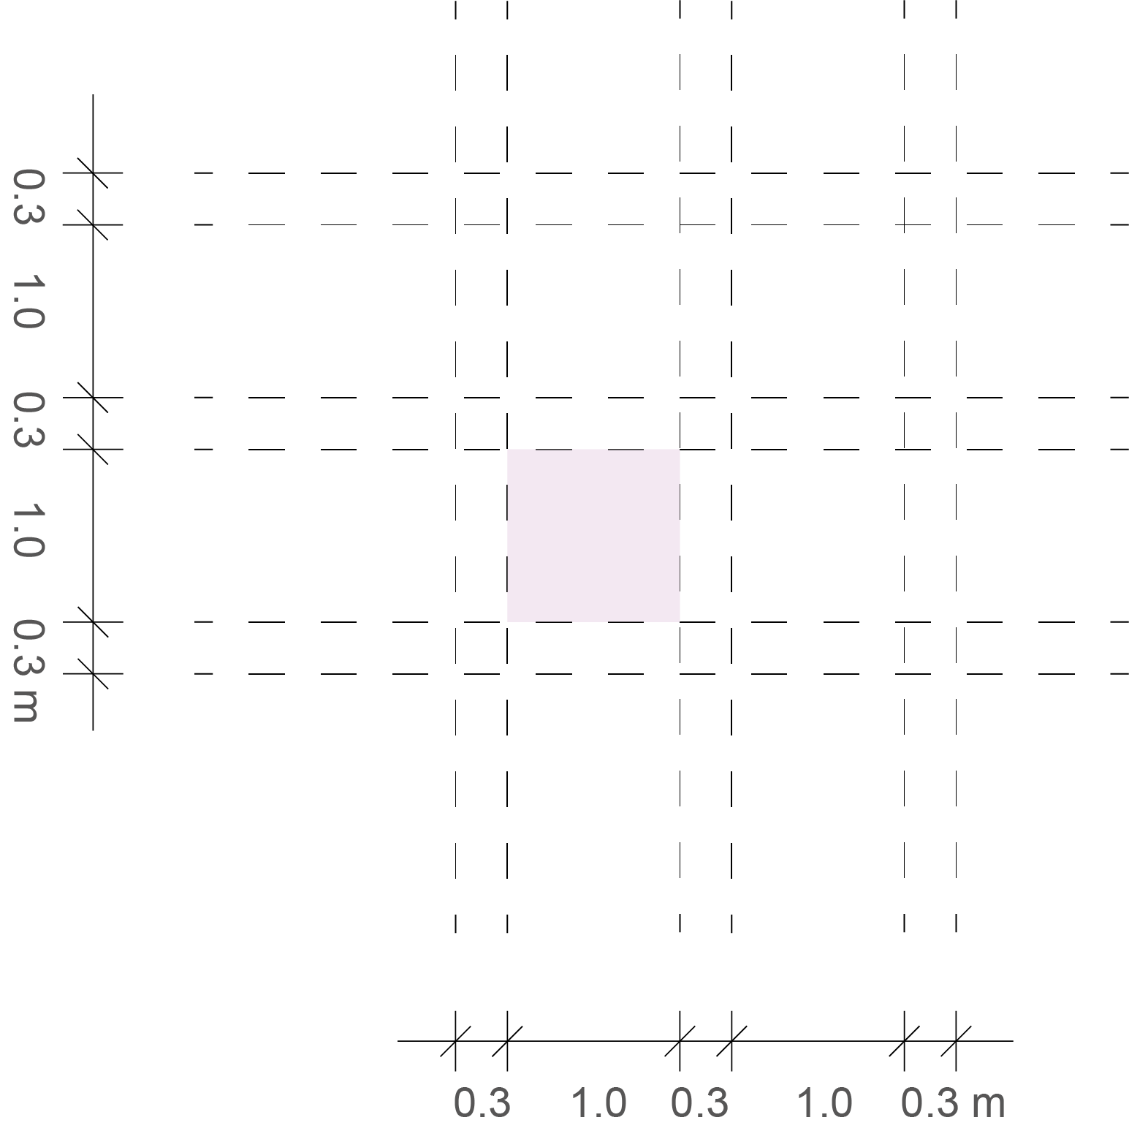
3.3 | Configuring | Grid
Conclusions
Starting with grid of 1m
Tartan grid would be best, so hallways are 1m
Wheelchair needs a 1.5m turning circle
So, 1m tartan grid too small
Go with 1.5m tartan grid
1m basic grid
1.5m basic grid
1m tartan grid
1.5m tartan grid

Slide 18
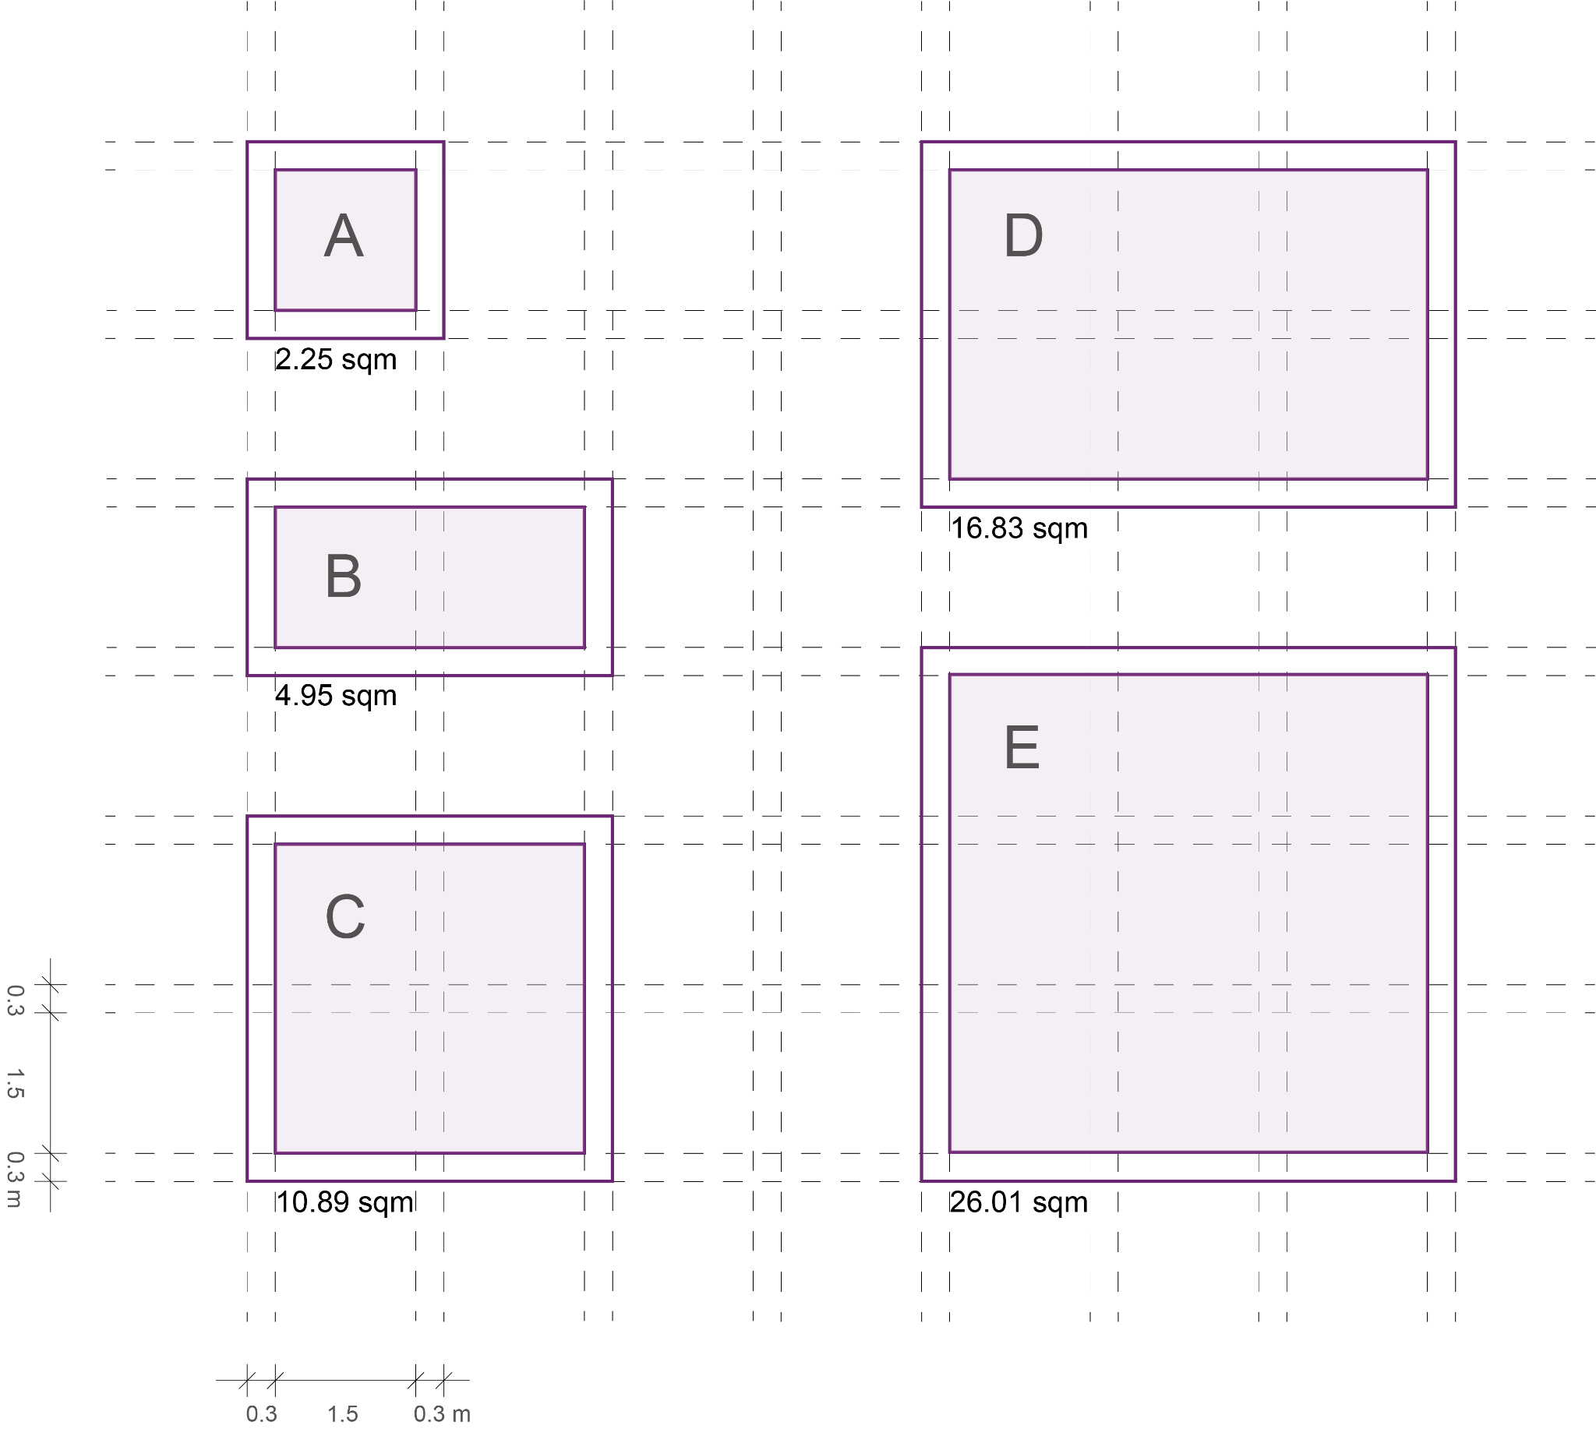
3.3 | Configuring | Size and Shape

Slide 19
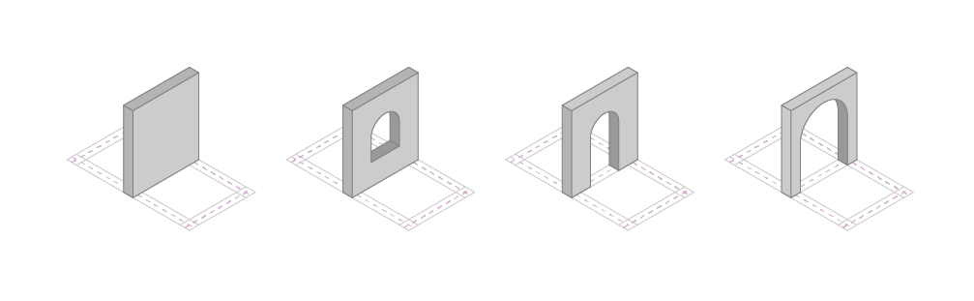
3.3 | Configuring | Wall Types
W1
Wall 1 - Solid
W2
Wall 2 - Window
W3
Wall 3 - Door
W4
Wall 4 - Completely Open

Slide 20
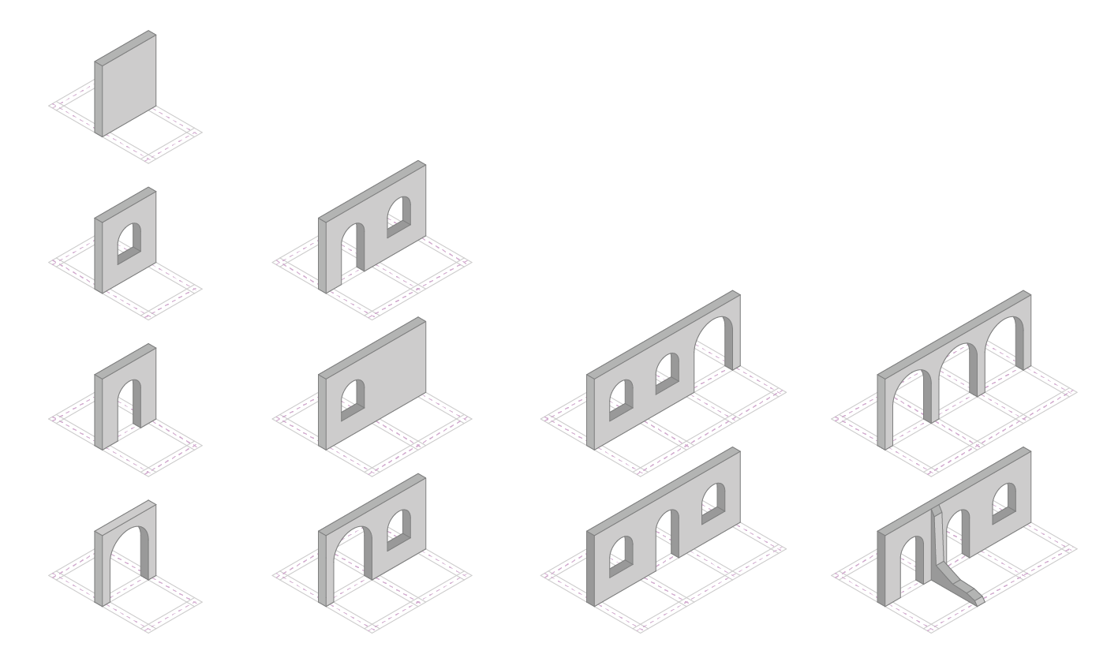
3.3 | Configuring | Wall Combinations
Double wall
Triple wall
Base Walls

Slide 21
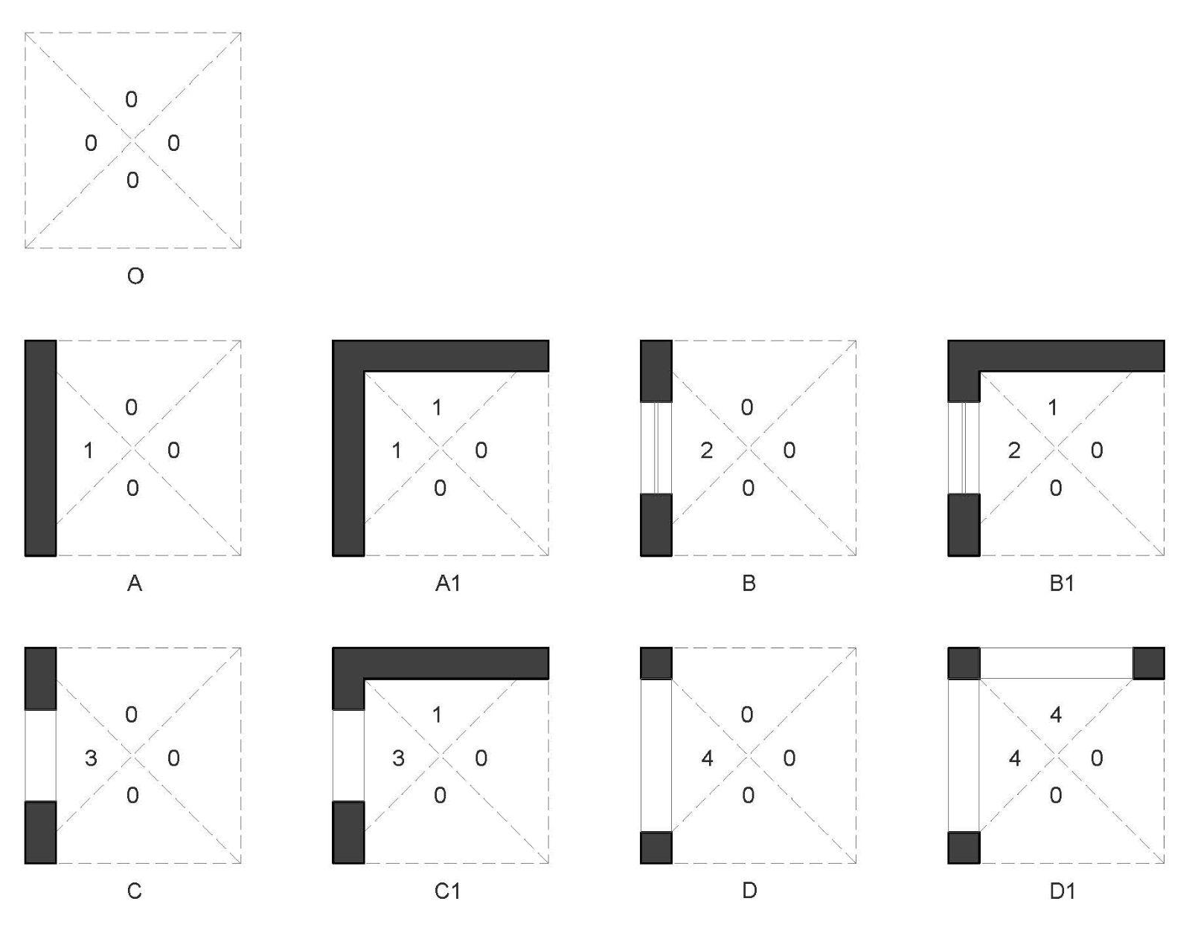
3.3 | Configuring | Carcassonne Tiles
Tile Rules
Tiles can mirrored & rotated
0 can connect to all other types, but will take character of the neighbouring tile
0 - Open
1 - W1 Type (Solid Wall)
2 - W2 Type (Window)
3 - W3 Type (Door)
4 - W4 Type (Open Arch)

Slide 22
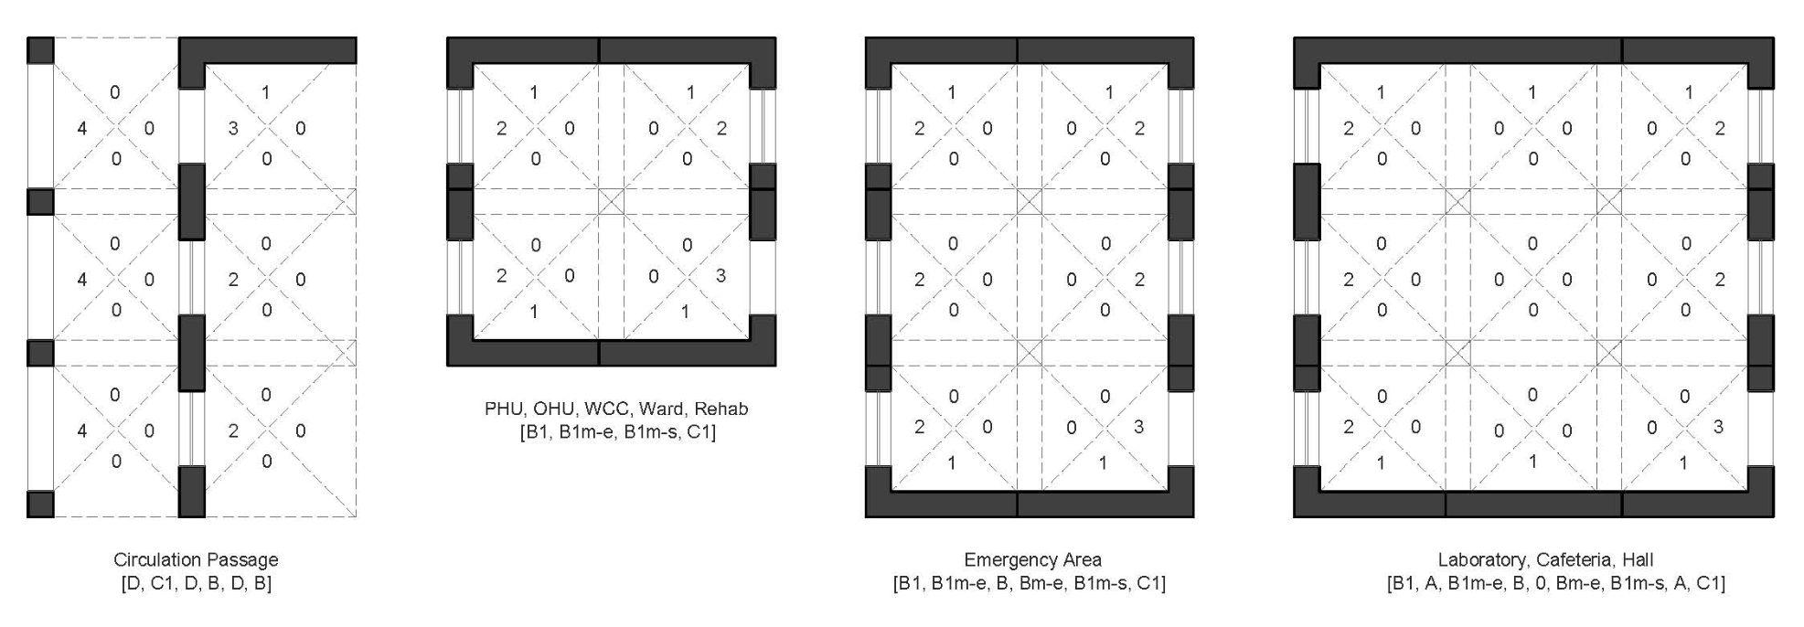
3.4 | Configuring | Carcassonne Tiles
m-mirror,
e-east
s-south

Slide 23
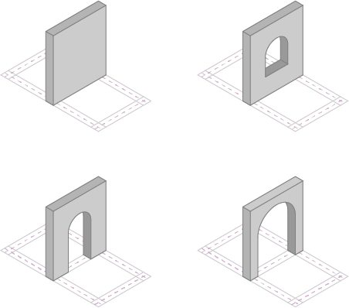
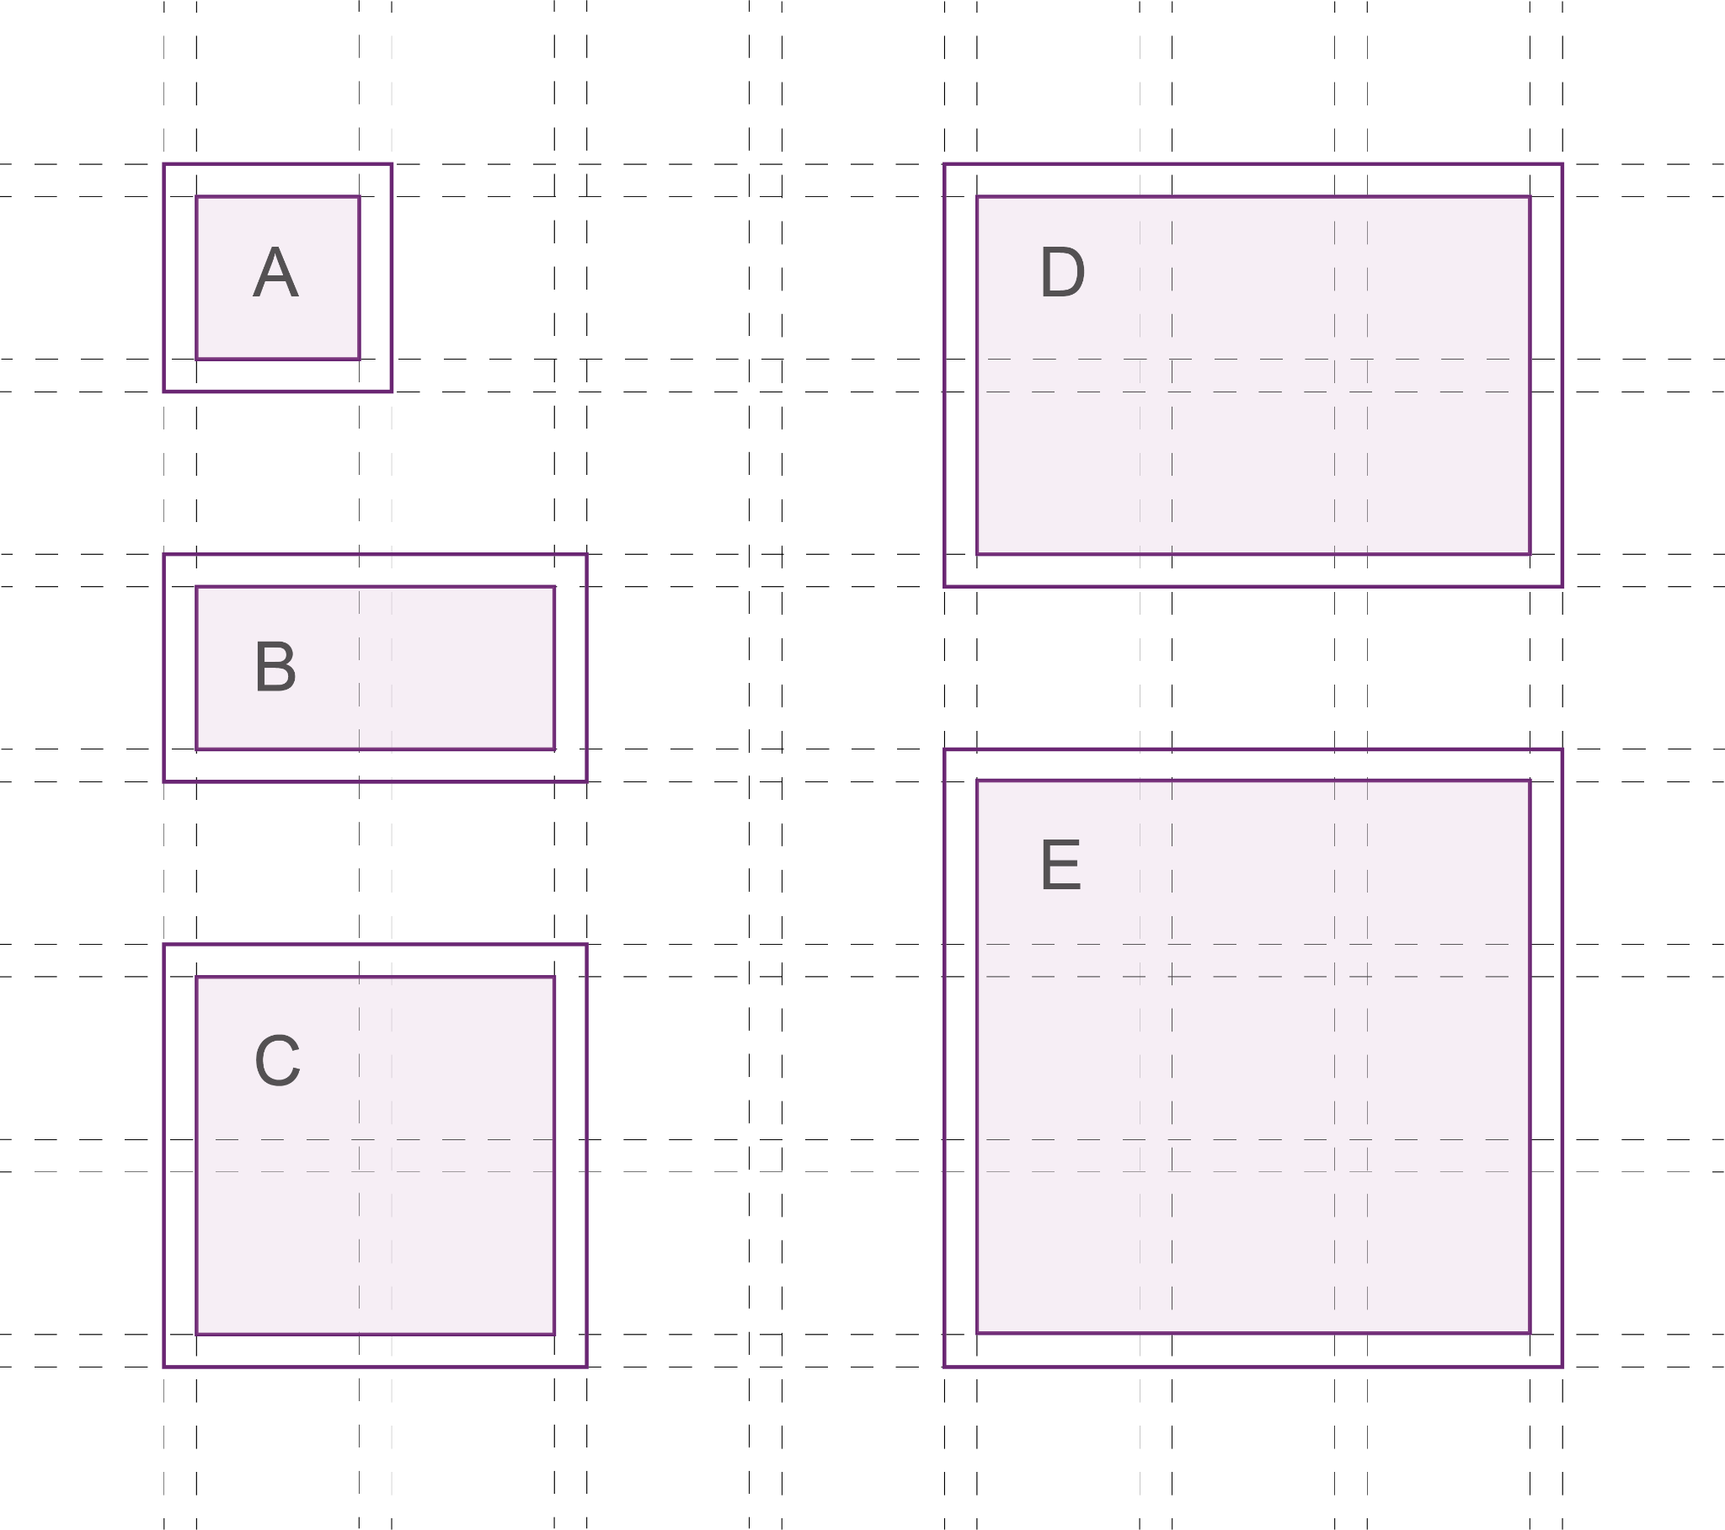
3.5 | Configuring | Function Modules
W1
W2
Function name | Size of module | W1 | W2 | W3 | W4
Circulation | A - 4 | 0 | 1 | 0 | 3
Reception General Toilets Fore-court / Waiting Area Primary Healthcare Unit - PHU Emergency Care | B - 6 B - 6 C - 8 C - 8 D - 10 | 4 4 1 4 3 | 0 1 4 3 2 | 0 1 1 1 2 | 2 0 2 0 0
Showers Pharmacy Records Room Staff Room Ward Oral Health Unit Womens and Childcare Unit Rehabilitation Unit Hall for counselling/awareness/immunization drives Cafeteria + kitchen Lab | A - 4 B - 6 B - 6 B - 6 C - 8 C - 8 C - 8 C - 8 E - 12 E - 12 E - 12 | 2 4 4 2 4 4 4 4 6 6 5 | 1 1 1 3 3 3 3 3 4 5 3 | 1 1 1 1 1 1 1 1 2 1 1 | 0 0 0 0 0 0 0 0 0 0 0
W3
W4
Notes:
The 5 predefined sizes - ABCDE - we had derived earlier will be assigned to the function.
These blocks have a total number of ‘edges’ which are then assigned the wall modules.

Slide 24
3.6 | Configuring | Density Factor
The hospital will serve around 10.000 residents, resulting in 100 visitors per day*
Functions | Capacity | Needed functions per 1000 ppl | Needed functions total | % of visitors* | Function amount | Final amount
Fore-court / Waiting Area | 100 | 0,1 | 1,0 | 1 | 1,0 | 2
Reception | 100 | 0,1 | 1,0 | 1 | 1,0 | 2
General Toilets | 20 | 0,5 | 5,1 | 1 | 5,1 | 6
Primary Healthcare Unit - PHU | 25 | 0,4 | 4,1 | 0,3 | 1,2 | 2
Emergency Care | 20 | 0,5 | 5,1 | 0,3 | 1,5 | 2
Pharmacy | 100 | 0,1 | 1,0 | 0,5 | 0,5 | 1
Hall for counselling /awareness/immunization drives | 50 | 0,2 | 2,1 | 0,5 | 1,0 | 2
Cafeteria + kitchen | 100 | 0,1 | 1,0 | 0,75 | 0,8 | 1
Oral Health Unit | 20 | 0,5 | 5,1 | 0,2 | 1,0 | 2
Womens and Childcare Unit | 20 | 0,5 | 5,1 | 0,2 | 1,0 | 2
Rehabilitation Unit | 25 | 0,4 | 4,1 | 0,2 | 0,8 | 1
Ward | 5 | 2 | 20,5 | 0,2 | 4,1 | 5
Showers | 10 | 1 | 10,3 | 0,2 | 2,1 | 3
Lab | 50 | 0,2 | 2,1 | 0,1 | 0,2 | 1
Records Room | 50 | 0,2 | 2,1 | 0,05 | 0,1 | 1
Staff Room | 20 | 0,5 | 5,1 | 0,2 | 1,0 | 2
Estimated numbers using
*Source: https://www.cbs.nl/nl-nl/nieuws/2013/27/ongeveer-drie-kwart-bezoekt-jaarlijks-huisarts-en-tandarts
Notes:
We calculated an average rate of patients and therefore the required capacities of the functions,
based on space standards and regulations.
This helped us come up with a number of eg; wards we need to provide.

Slide 25
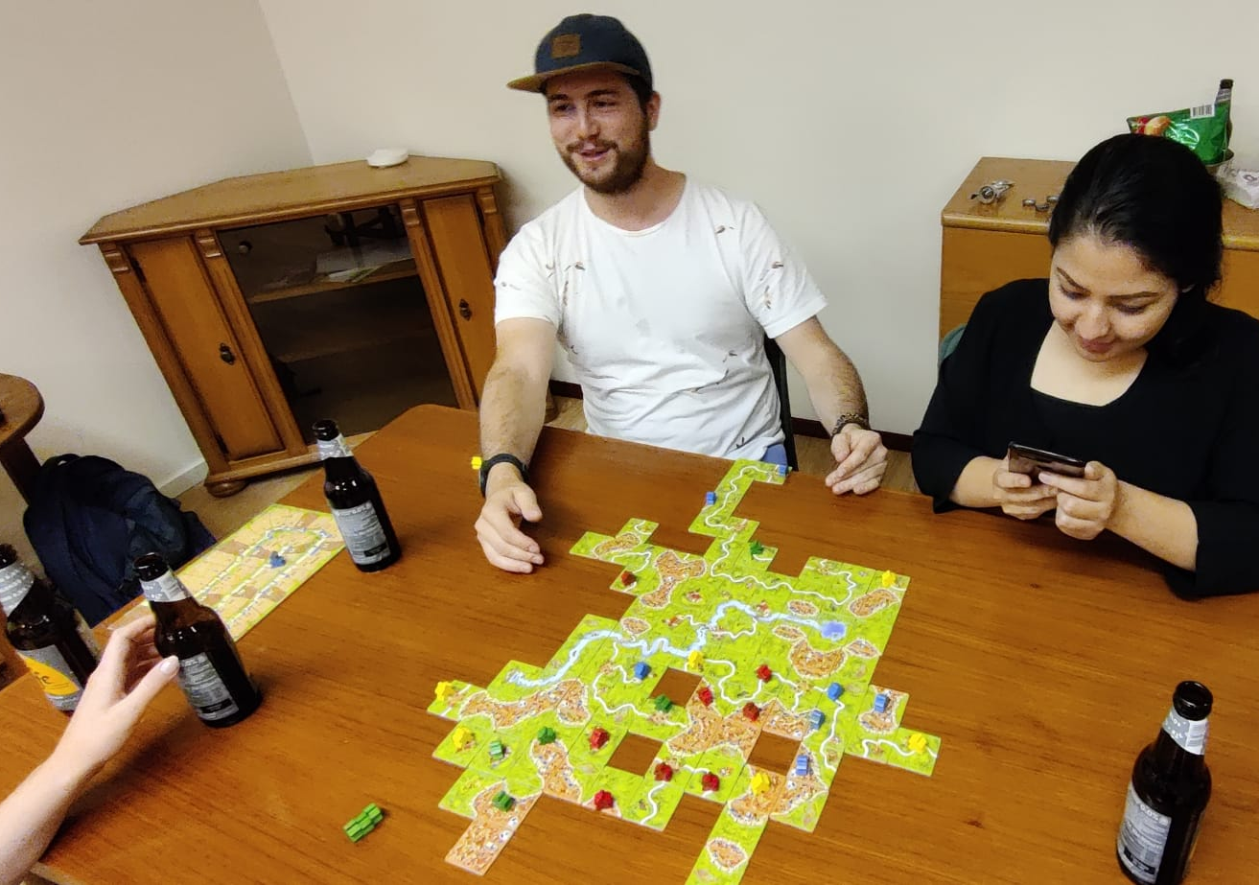
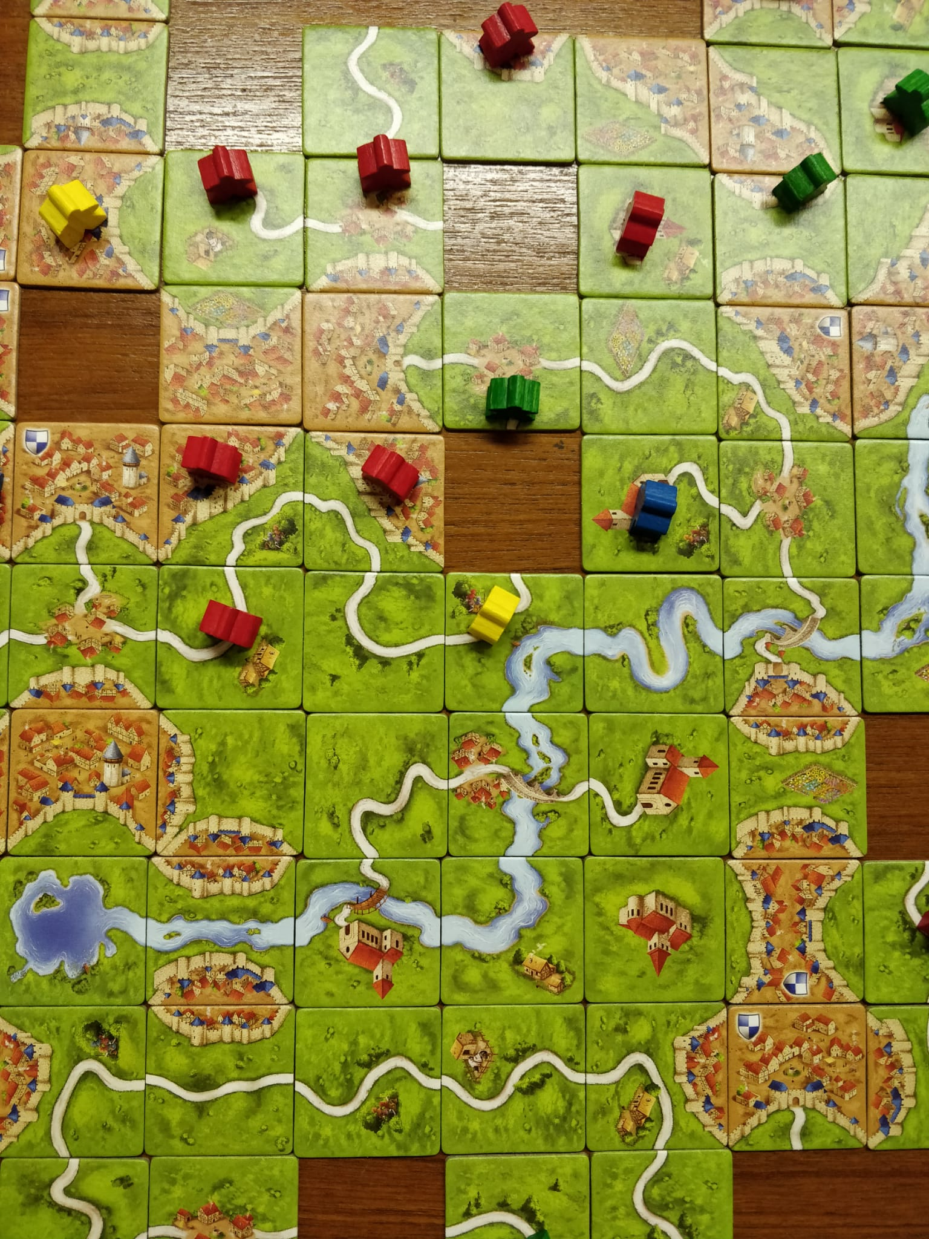
3.7 | Configuring | Space Layout Configurations
Notes:
We then started to generate some layouts manually.
We explain in the next slide..

Slide 26
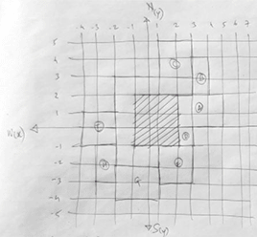
3.7 | Configuring | Space Layout Configurations (manual approach)
STEP 1
A grid is identified with a center point at (0,0)
STEP 2
A rectangular courtyard (with a minimum dimension limit) is created around it.
STEP 3
The ‘empty space’ is allotted based on location of the main road.
STEP 4
Emergency room placed first. Reception/ Forecourt placed next
STEP 5
Place additional functions as per required privacy.
Notes:
… the logic of how the plan can be generated.
Placing a rectangular courtyard at the beginning. It starts with a minimum width, length becomes twice the width.
The corridor is placed around it.
Identifying the edge with the main road
Placing the functions like reception and ER first
Then placing the other functions around it based on privacy levels and zones (which we explain later)

Slide 27
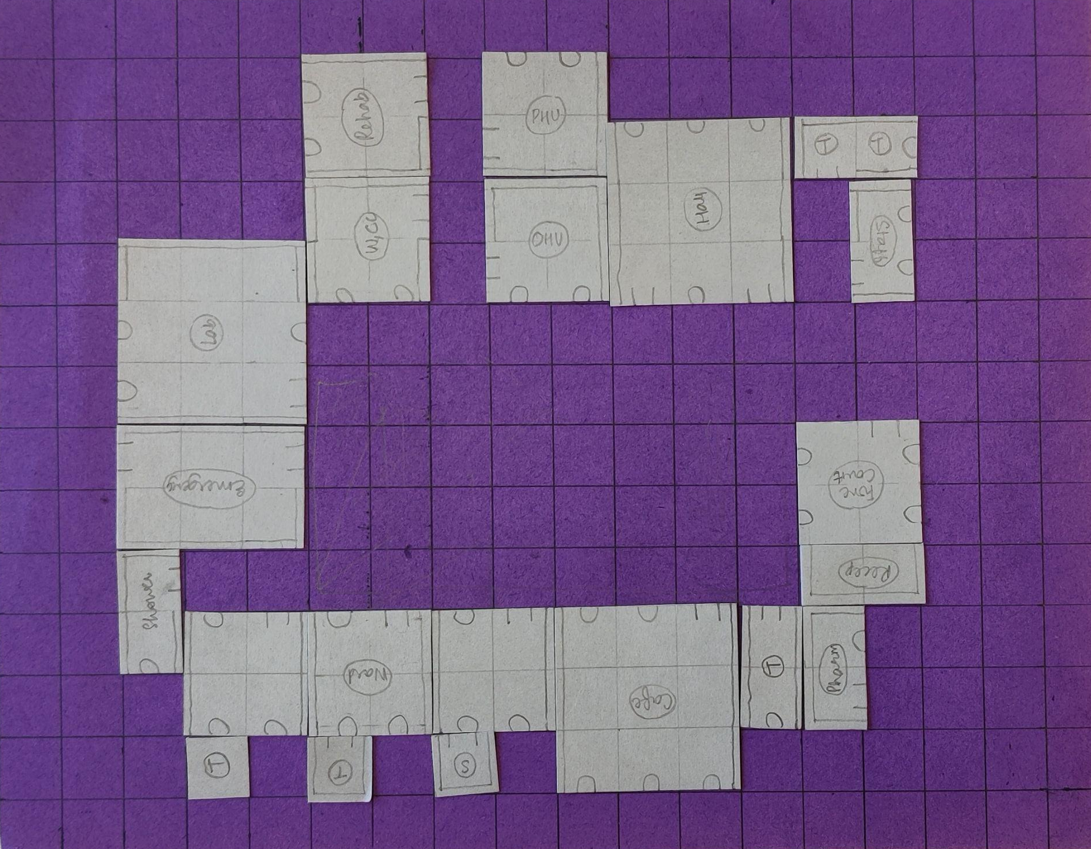
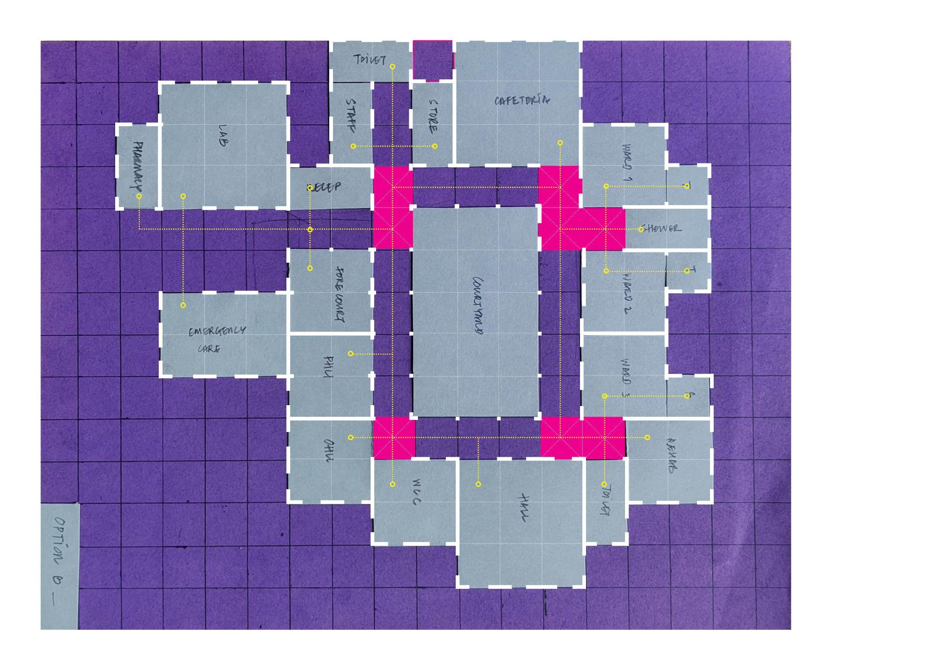
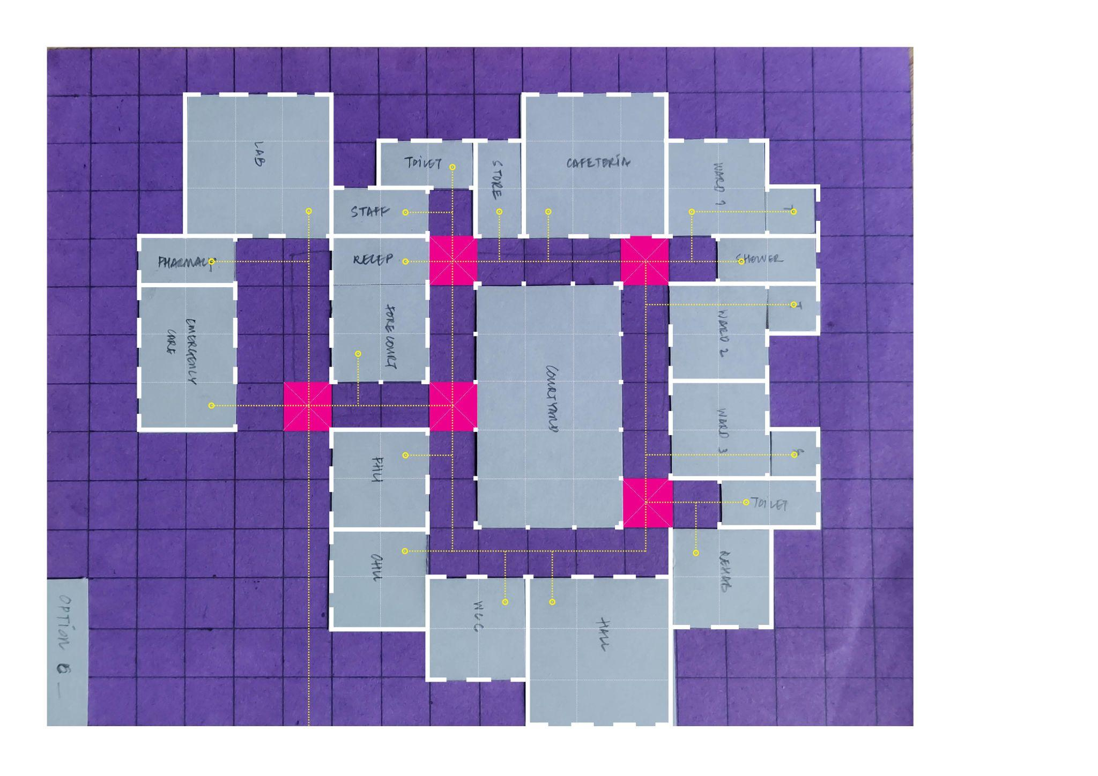
3.7 | Configuring | Space Layout Configurations
Configuration A
Configuration B
Configuration C
Pros | Cons
- Only one entrance to the facility - Inpatient and Outpatient facilities clubbed together - All areas have openings on 2 sides - Services are placed diagonally in plan | - Long corridor forming at the entrance - 3 openings into one corridor cell - possible overcrowding at access/egress of rooms.
Pros | Cons
- (Same as Configuration A) - Openings into corridors reduced to 2. | - No clear entry point leading to reception area.
Pros | Cons
- Inpatient and Outpatient facilities clubbed together. - clear division of ‘staff’ and ‘patient’ zone - Clear entry point - Ward is expandable | - Two accesses - No cross-ventilation in some functions (openings not located on opposite walls) - Formation of dead end.
Notes:
Manually, we made a few plans to understand the logic behind the configuration.
And tried to improve the plan configurations with each step.

Slide 28
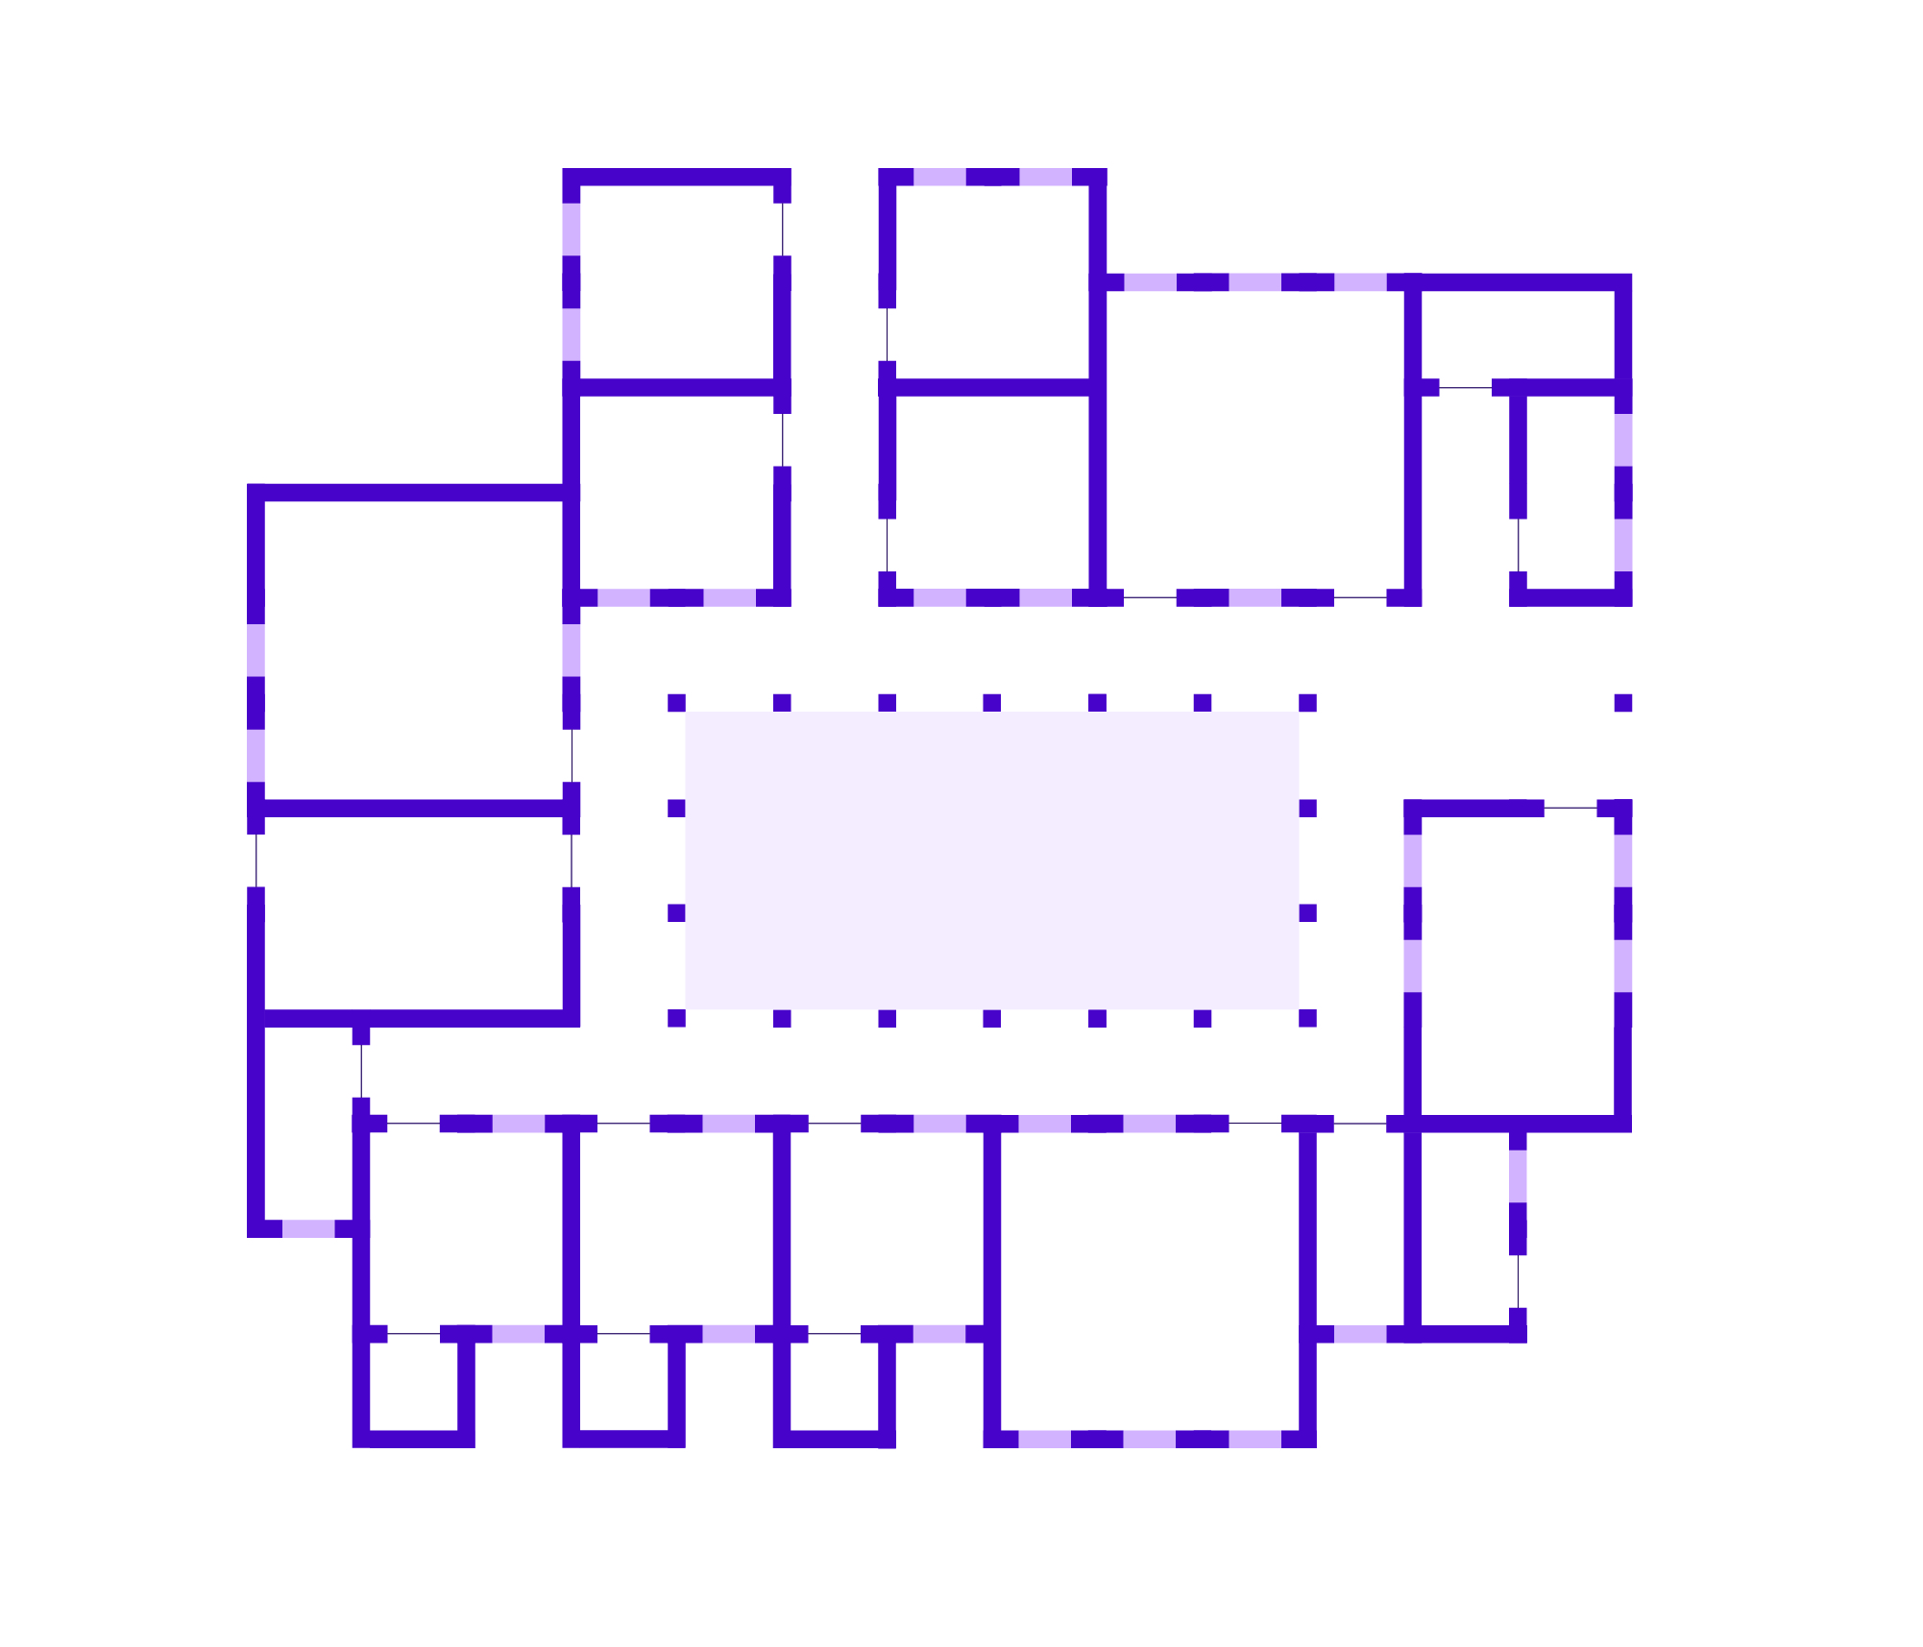
3.7 | Configuring | Space Layout Configurations Option C
Areas
Courtyard width minimum to be 3 blocks.
Courtyard length greater than 3*2 blocks.
Wall Module Configuration
Opposite walls in the room to be solid.
Opposite walls in the room to have openings/doors etc.
If the opening and solid clash, introduce an empty block.
Functions
Large hall can't come on top of large hall. Dome height will be very high. Large hall only on top of smaller 1x2, 1x3 spaces.
One side of ward to be left empty - no major functions.
Toilets placement - if there is a toilet block placed, the next one has to be diagonally opposite on the courtyard.
Emergency room placed first.
Reception and Forecourt placed next.
Next functions can be placed as per adjacency - Reception (connected to) Staff; Cafeteria (connected to) Ward and Staff;
Circulation
Intersection node should provide maximum 2 access to primary functions. Possible configurations - 2P, 2S; 1P, 3S
No access placed on corner voxels.
WCC
PHU
Hall
Staff
Room
Rehab// Physio
OHU
Lab
Emergency Room
Forecourt and Reception
Ward
03
Ward
02
Ward
01
Cafeteria and Kitchen
Pharmacy
Notes:
To develop it computationally, and work further on the roof shaping, we fixed plan C
Based on this we also drew some conclusions and (possible rules) for the configuration.

Slide 29
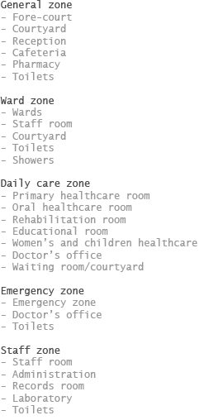
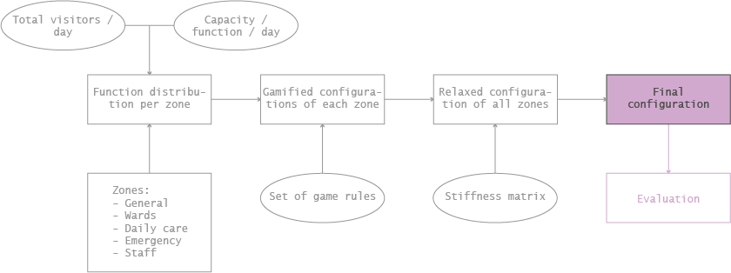
3.7 | Configuring | Computational Configuration - Flowchart
Notes:
Diederik

Slide 30
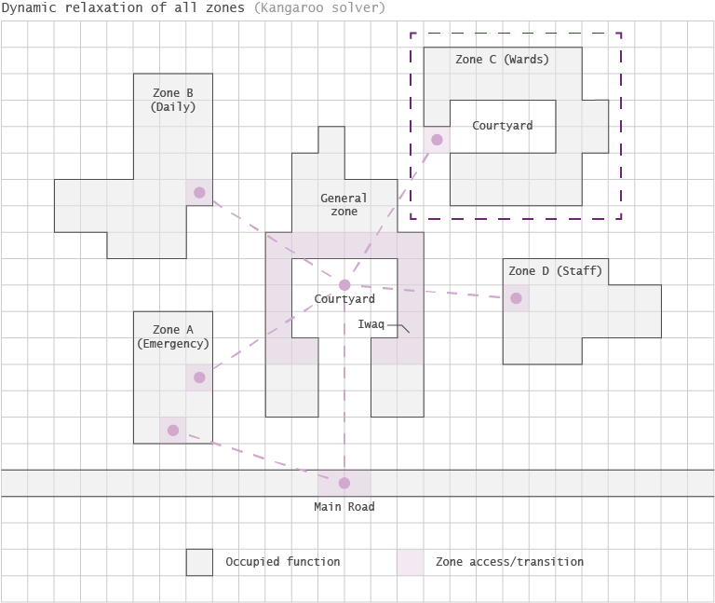
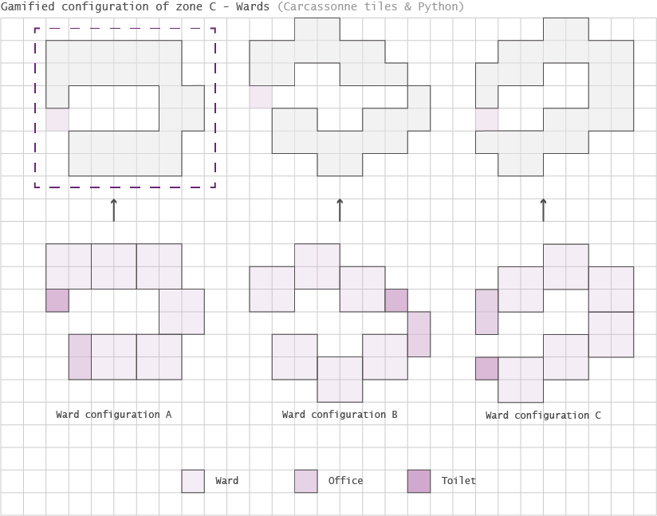
3.7 | Configuring | Computational Configuration of Zones
Example: this hospital requires six wards
Notes:
Diederik

Slide 31
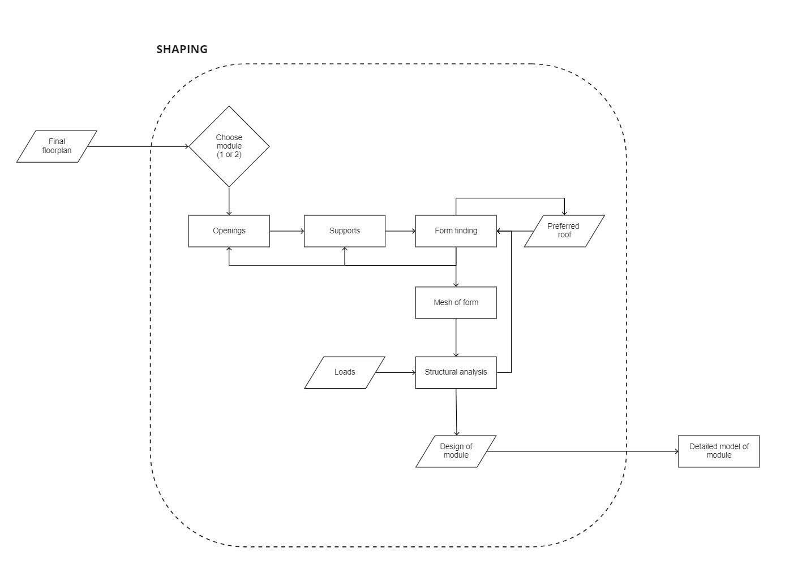
4.0 | Shaping

Slide 32
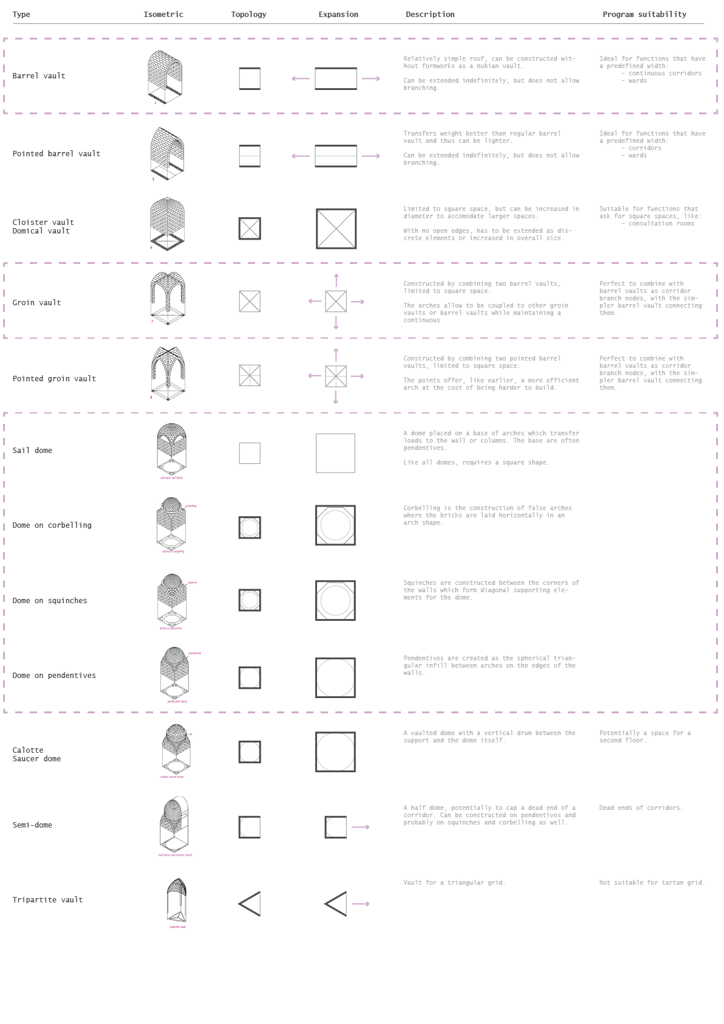
4.1 | Shaping | Roof typology analysis (1/2)
Notes:
Diederik

Slide 33
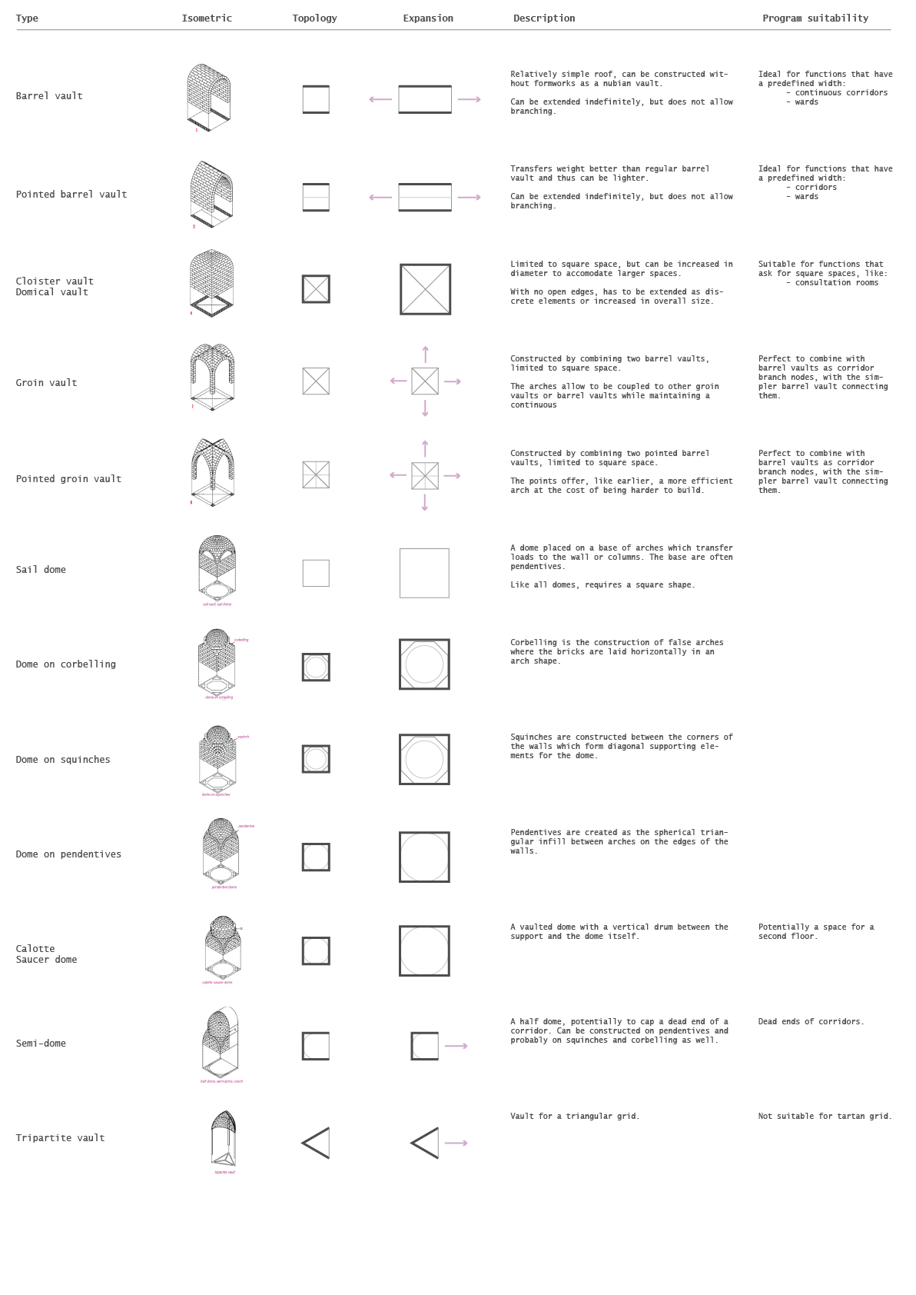
4.1 | Shaping | Roof typology analysis (2/2)
Notes:
Diederik

Slide 34
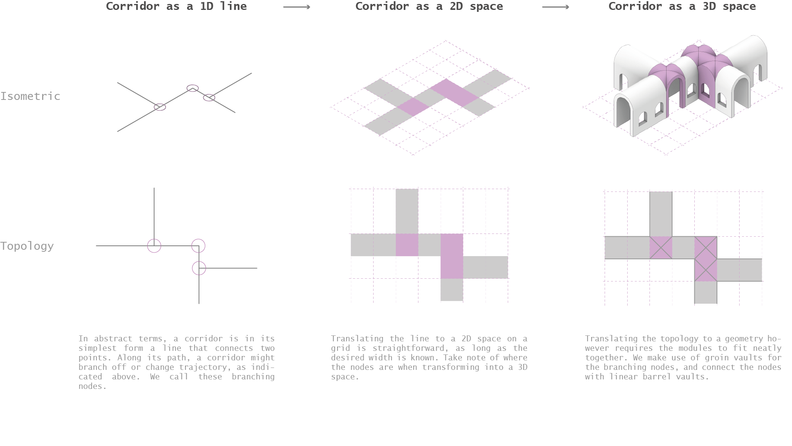
4.2 | Shaping | Circulation
Notes:
Diederik

Slide 35
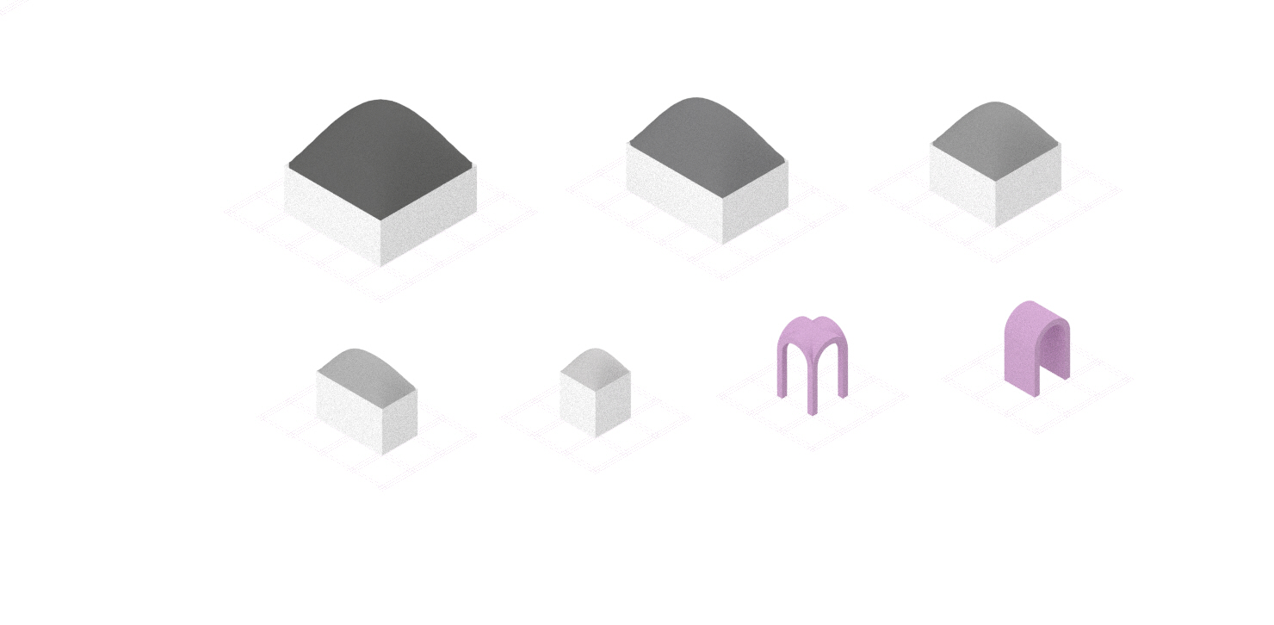
4.3 | Shaping | Isometric modules
E 3x3
D 3x2
C 2x2
B 2x1
A 1x1
A 1x1
A 1x1
Notes:
Diederik

Slide 36
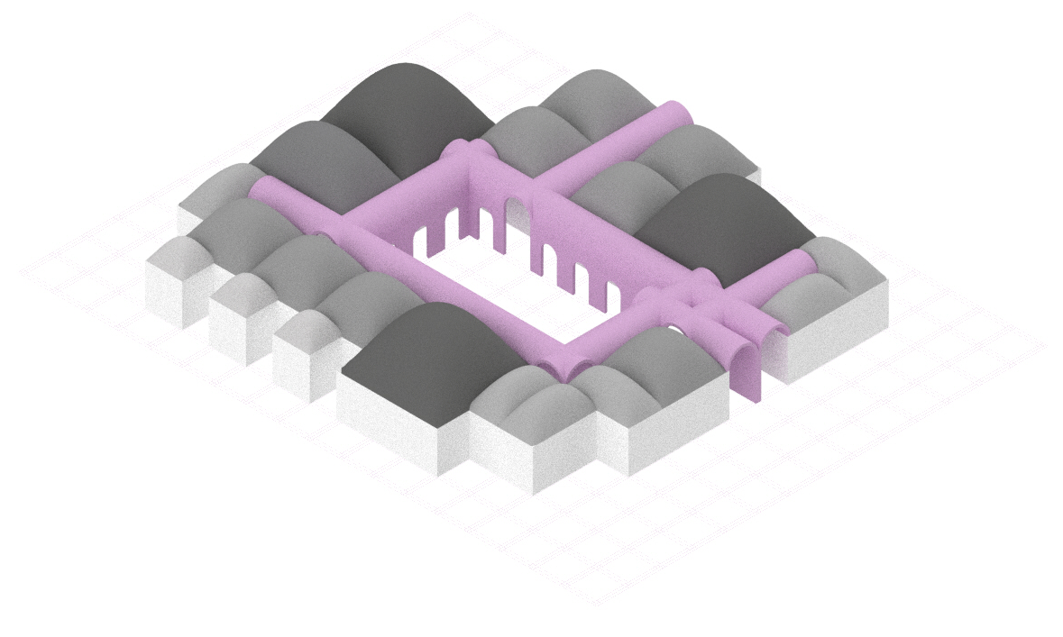
4.3 | Shaping | Space Layout Option C
WCC
PHU
Hall
Staff
Room
Rehab// Physio
OHU
Lab
Emergency Room
Forecourt and Reception
Ward
03
Ward
02
Ward
01
Cafeteria and Kitchen
Pharmacy
Notes:
Diederik

Slide 37
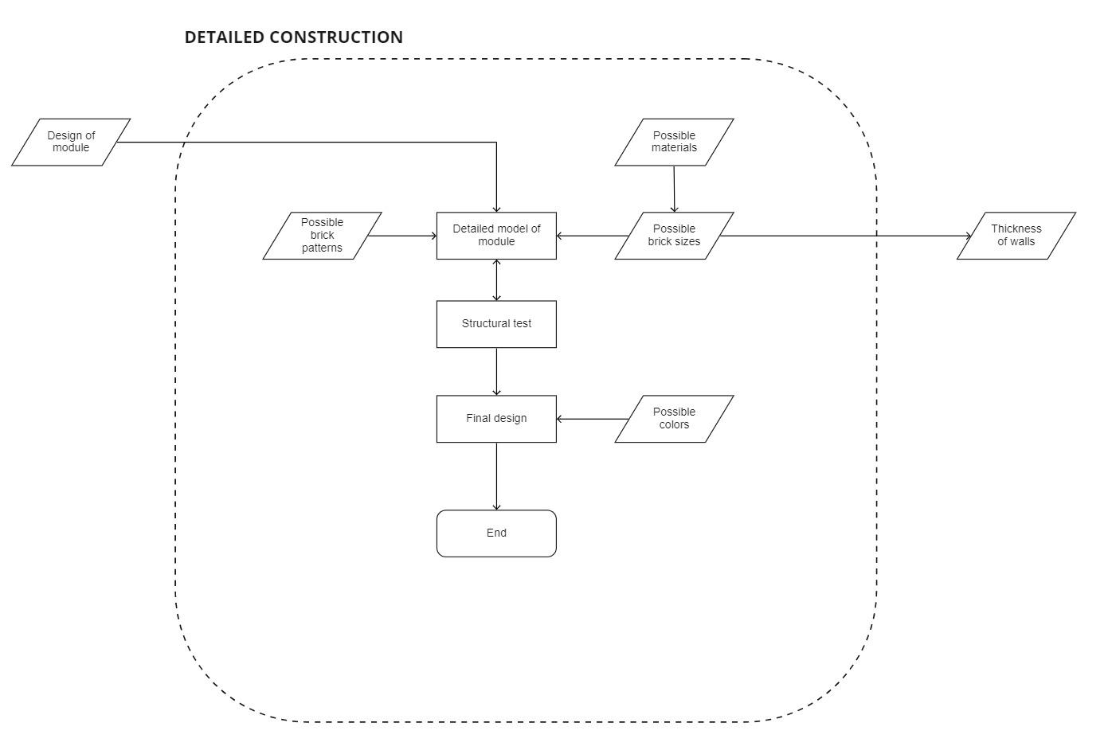
5.0 | Construction

Slide 38
6.0 | Next Steps
Configuration - Program the zone configuration on grasshopper using kangaroo. - Program the functions within the zone on python using carcassonne logic.
Shaping - Develop logic for configuring roof/ceiling. - Structural analysis of roof types and shape optimization.
Construction - Study into material composition and sizes of bricks. - Start with tessellation for the brick layering pattern.

Slide 39
Module Size Finding
Configuring

Slide 40
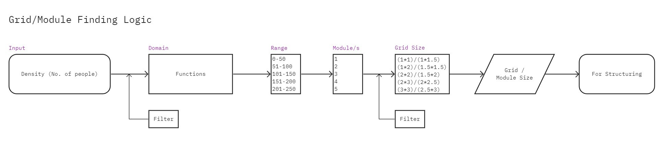
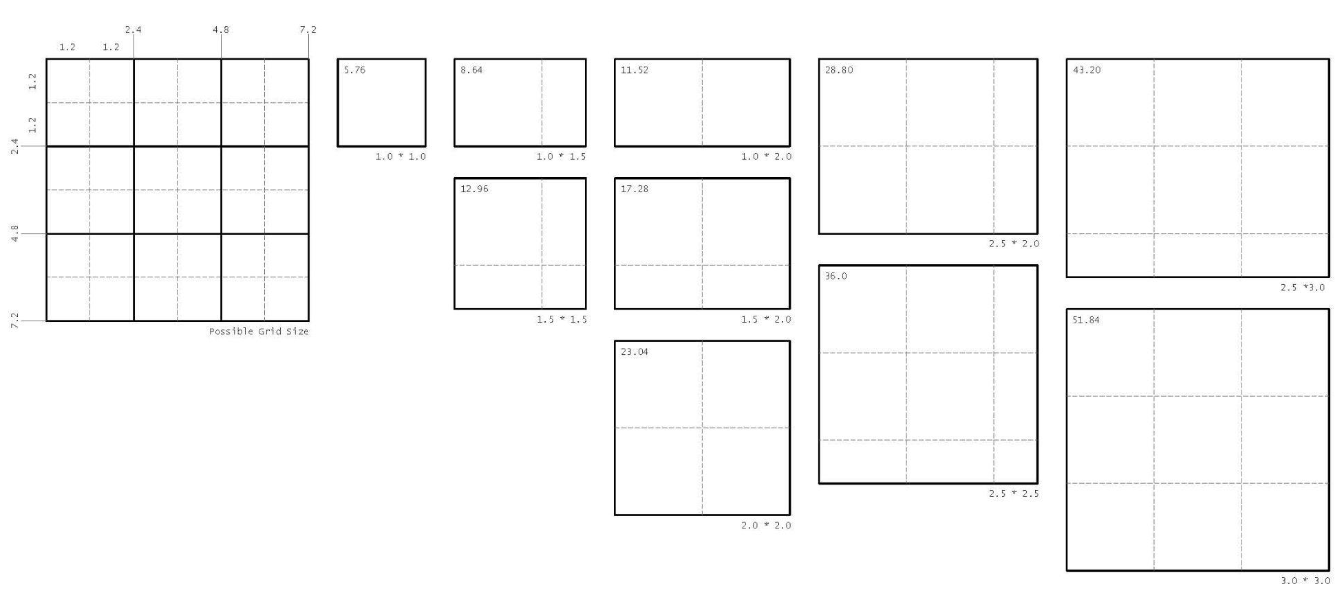
Configuring
Module Size
= X * No. of people
X is the fraction of function with respect to the total area.
For eg:
Forecourt Size
= 0.5 * 50 = 25 sq.m

